Slide 1
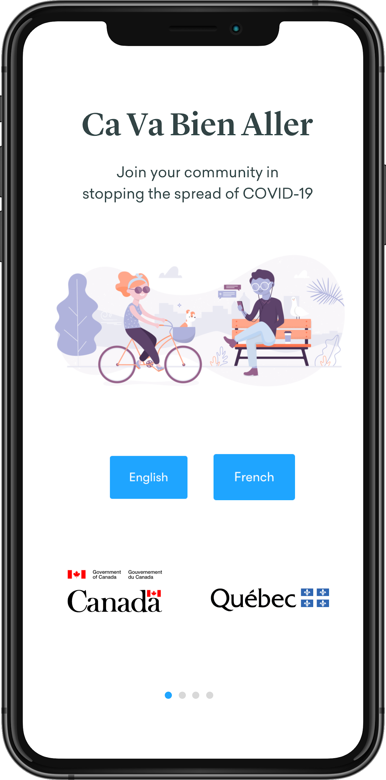
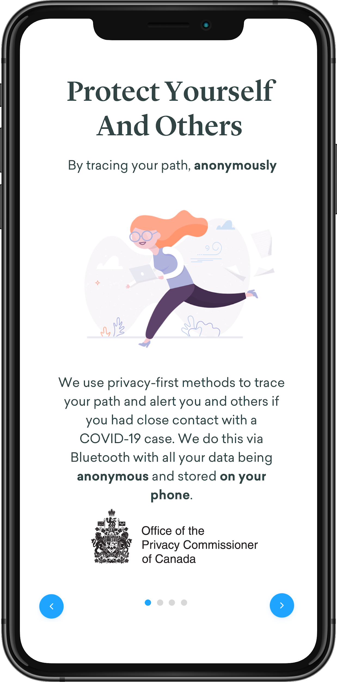
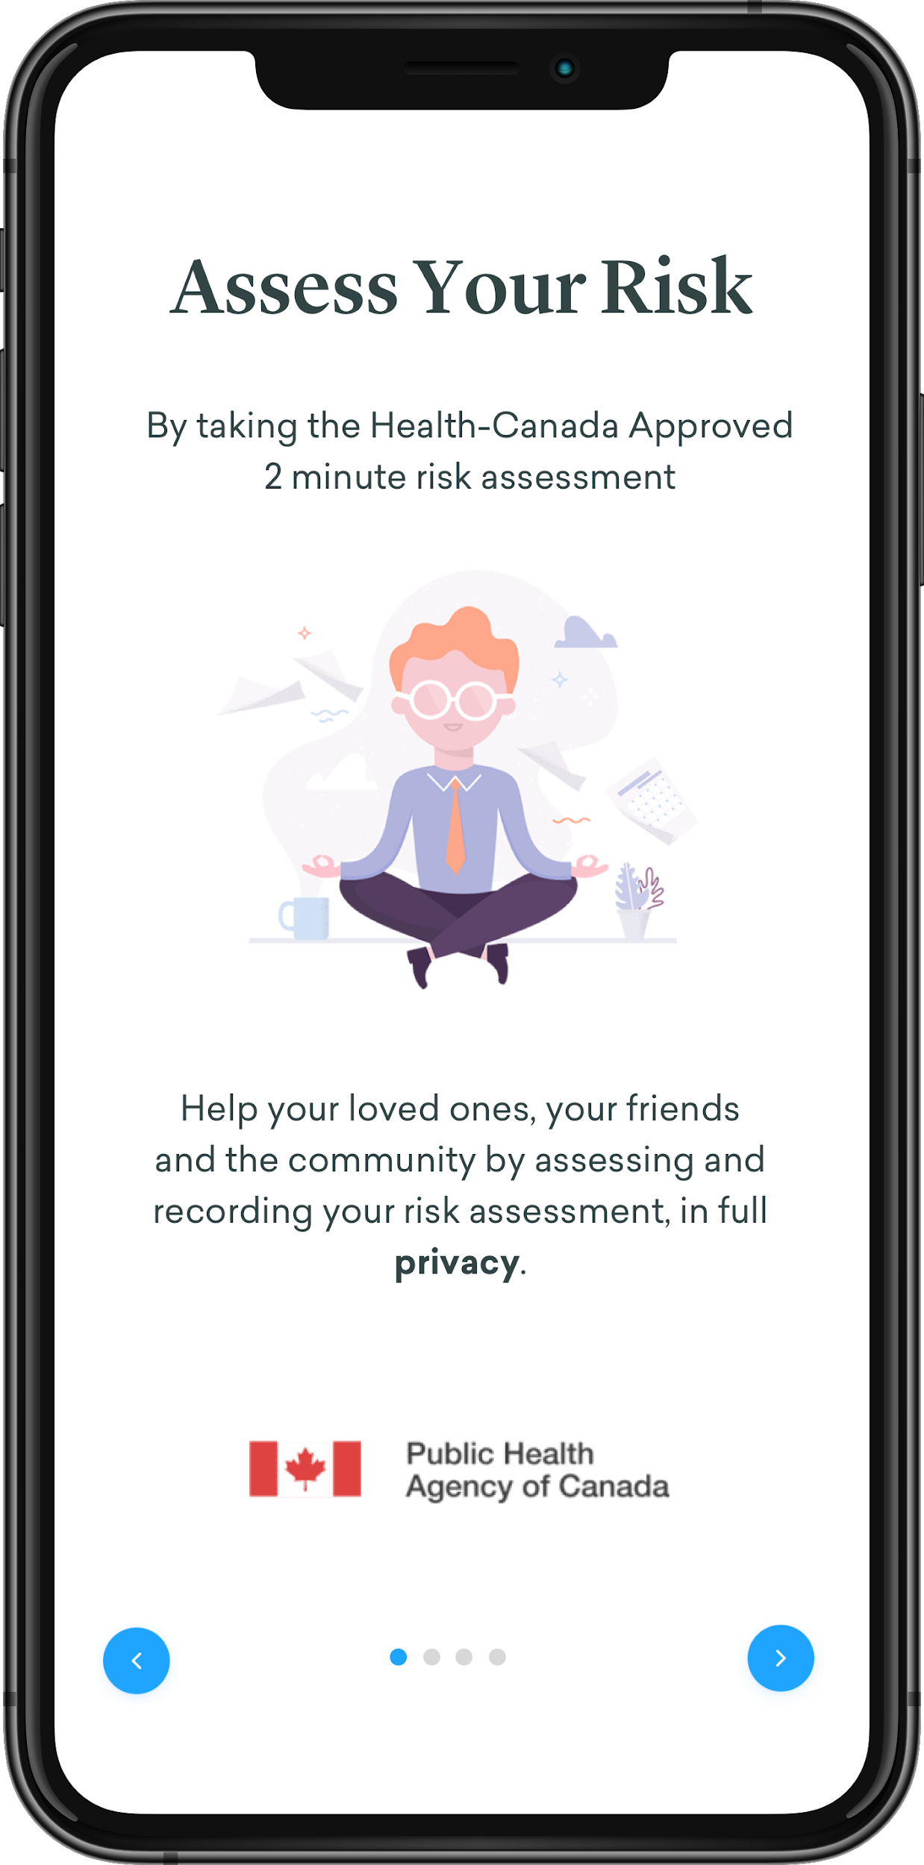
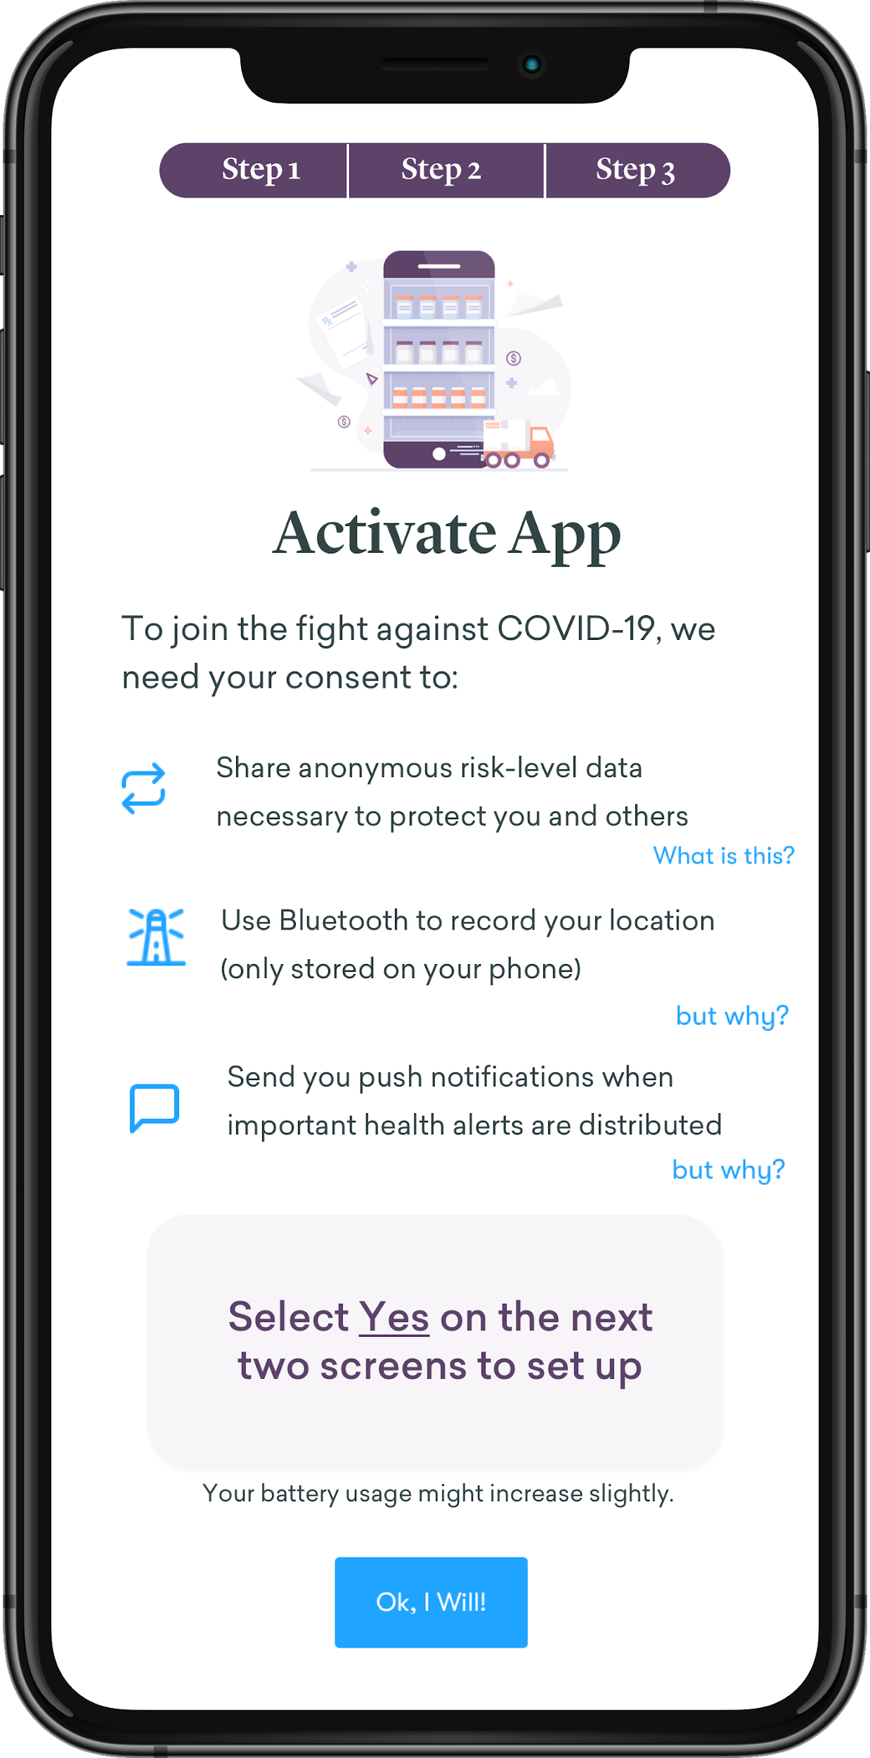
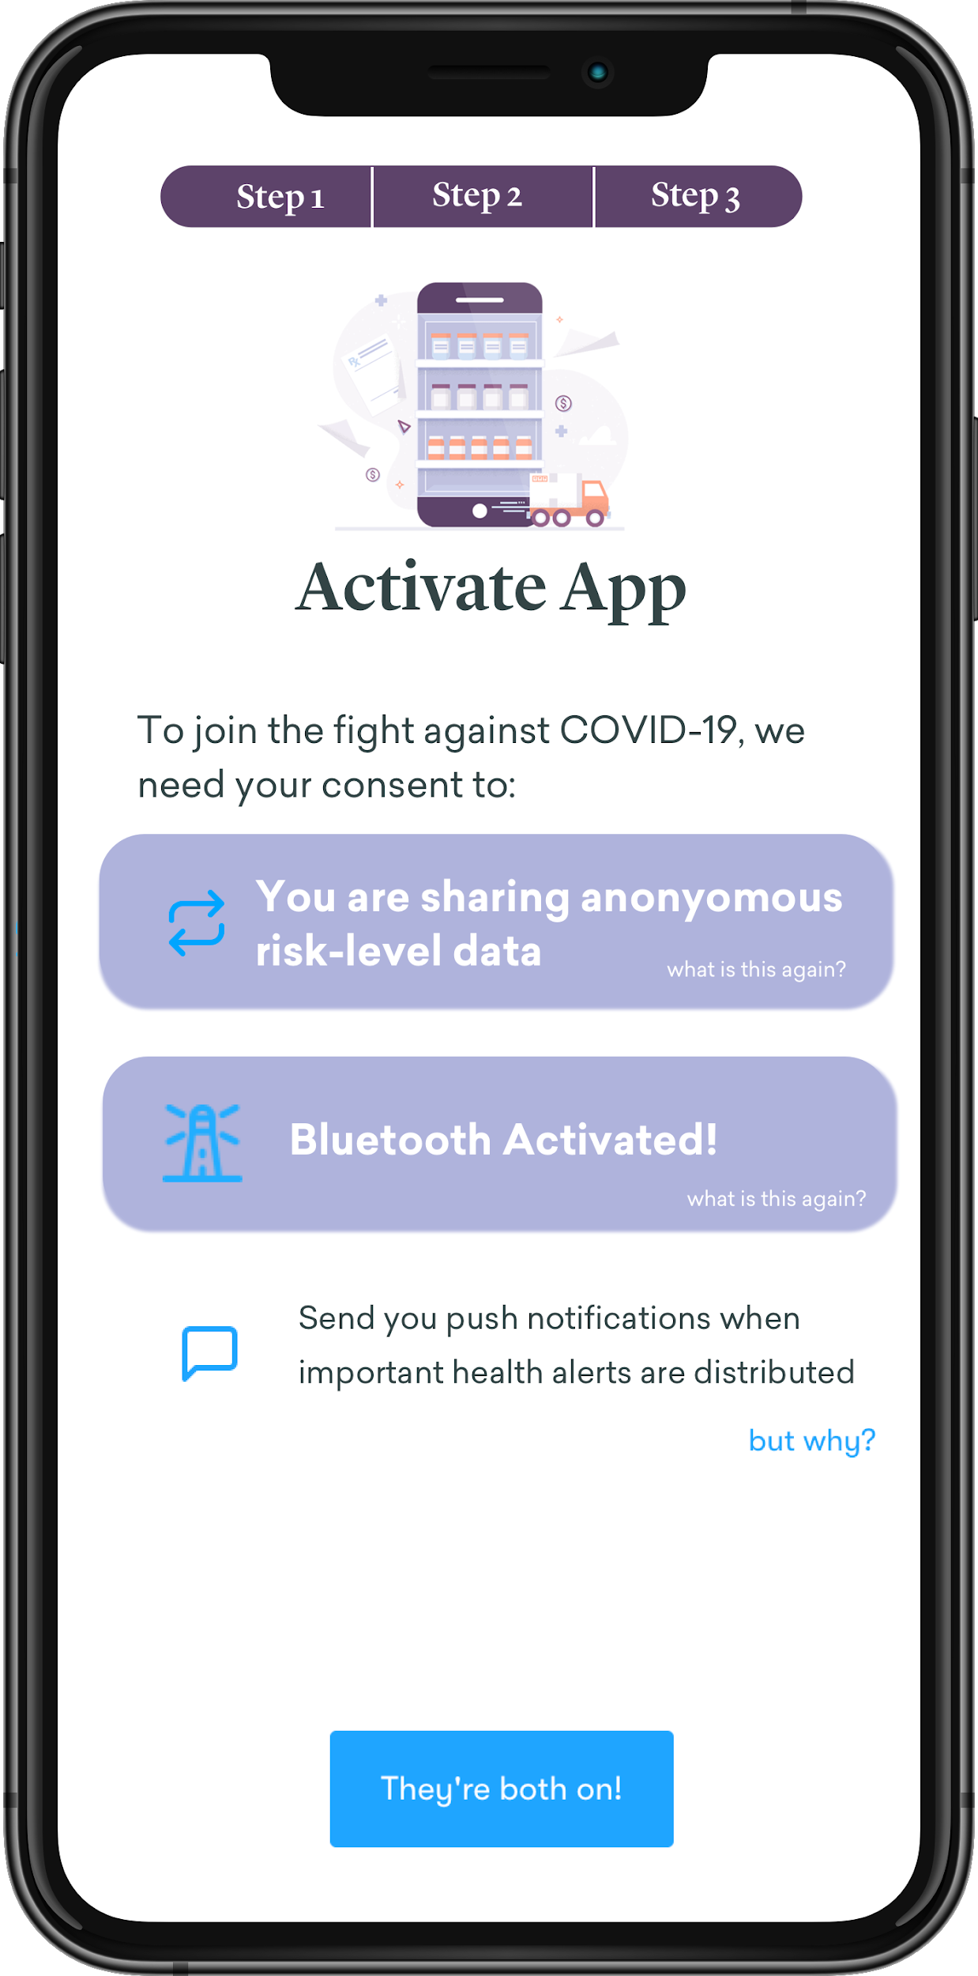
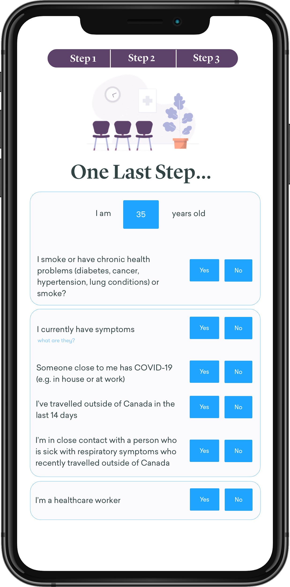
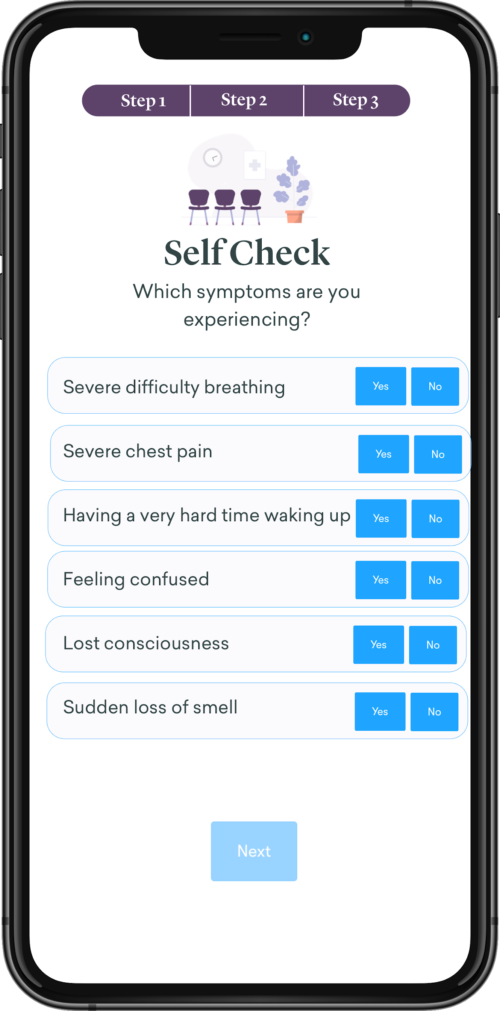
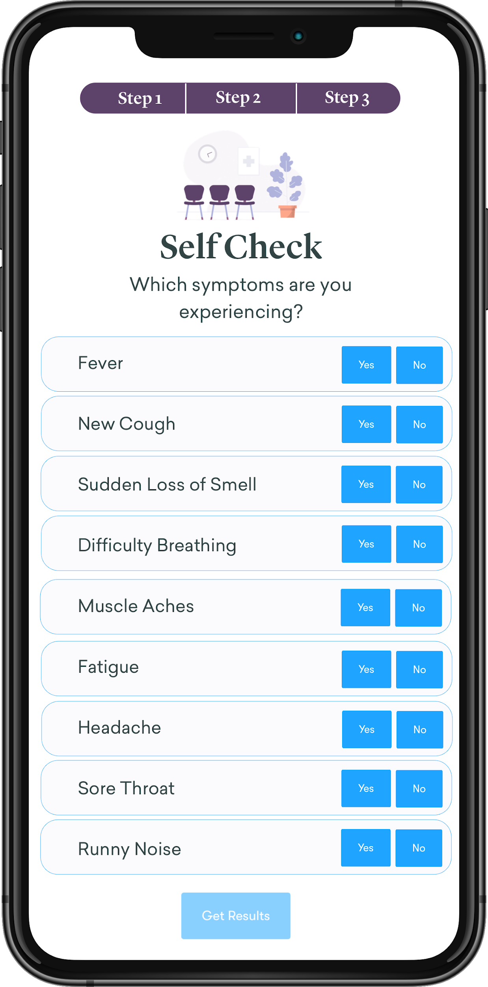
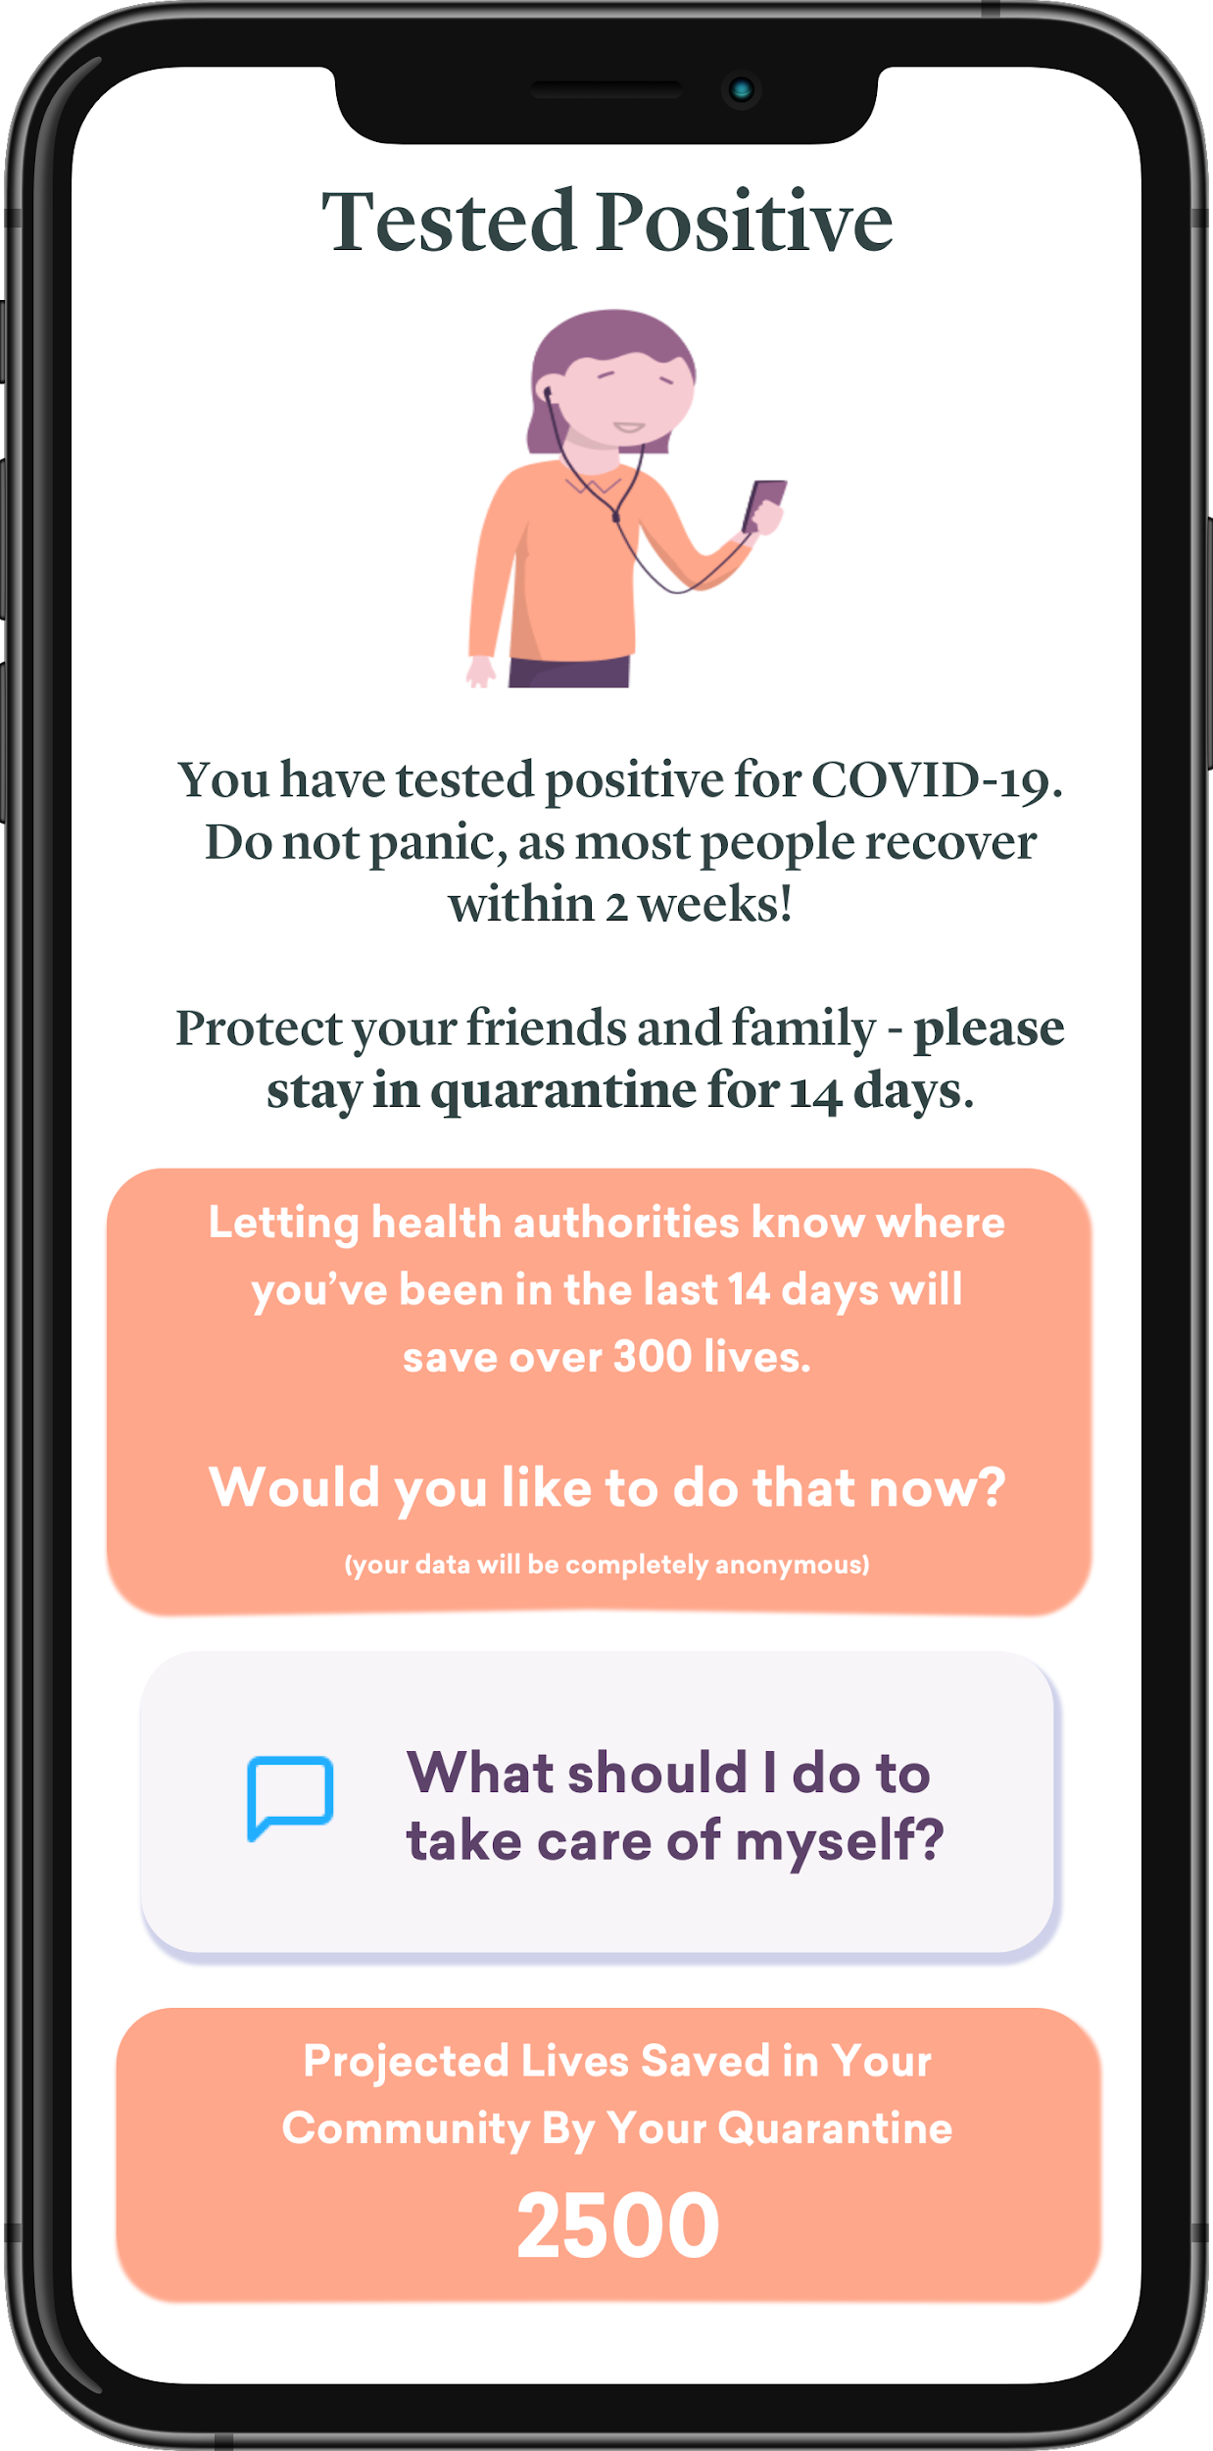
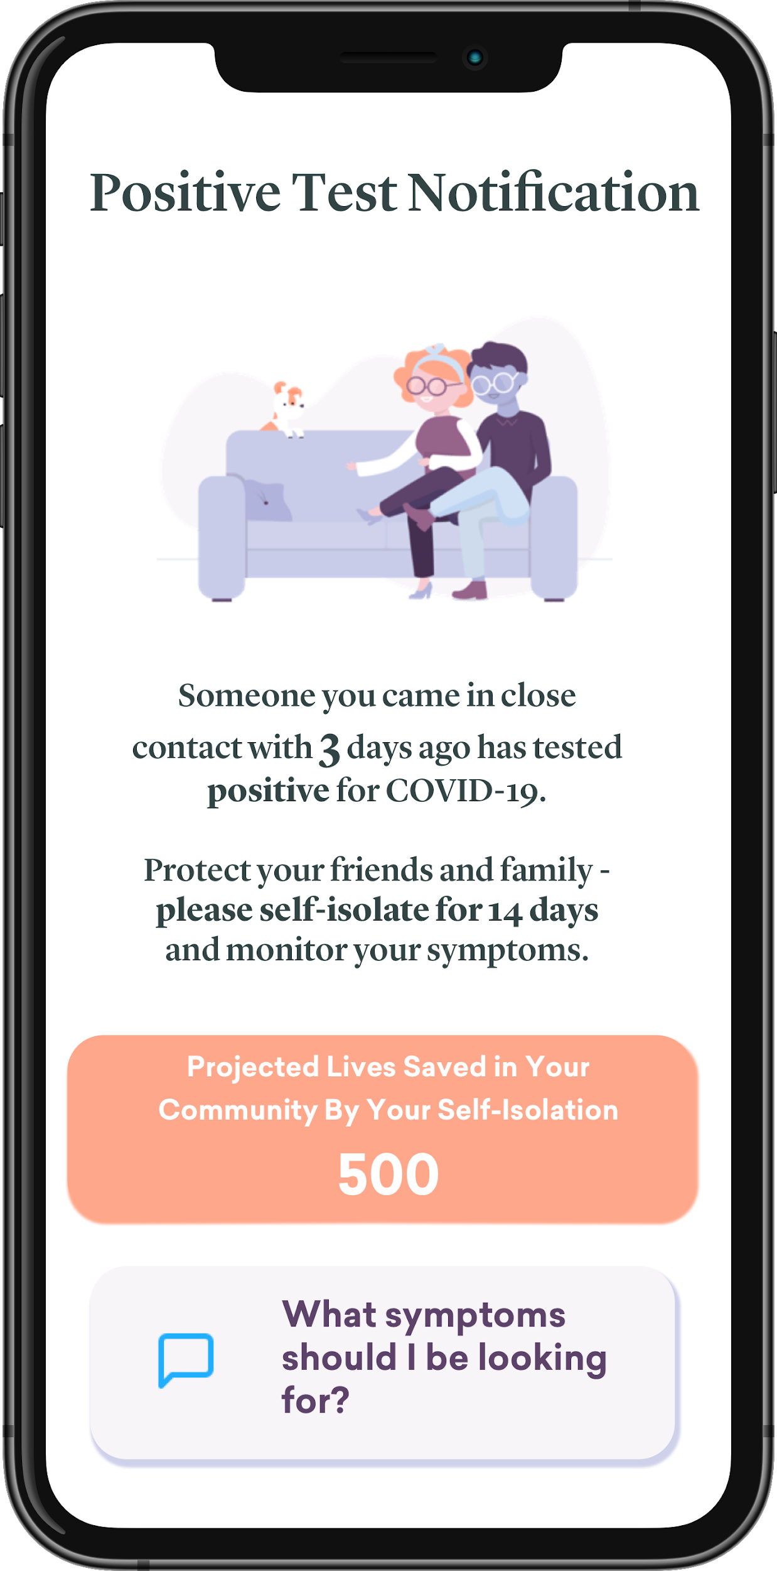
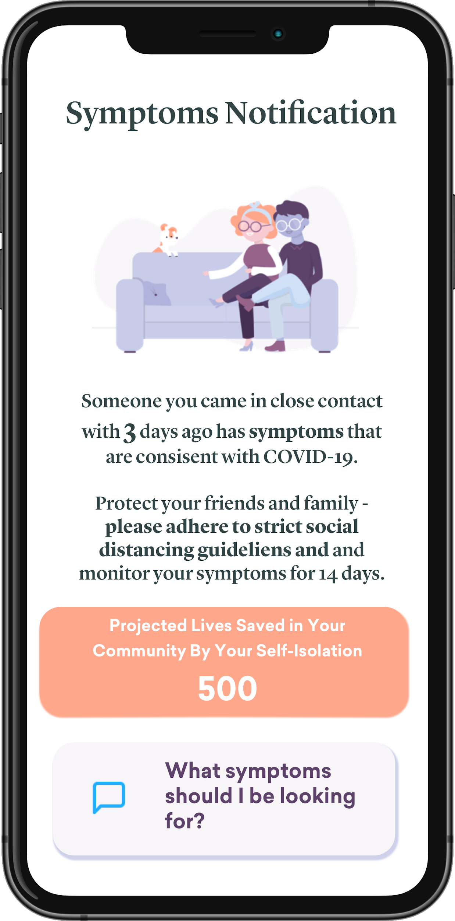
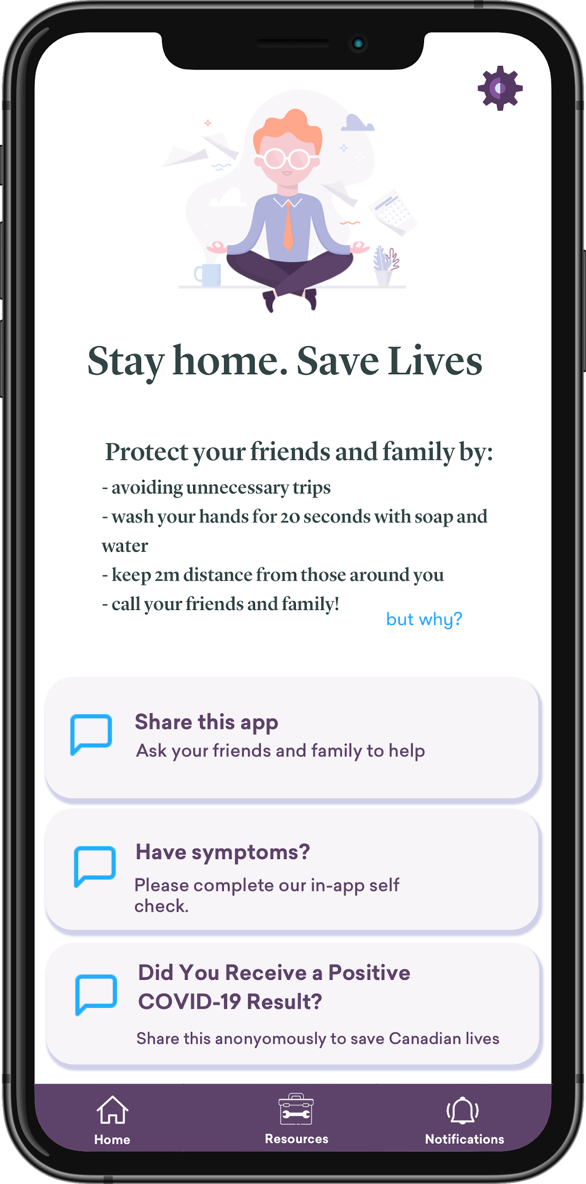
Normal Flow - No Symptoms (Not a HCP)
Intro screens + value prop explained (geolocated)
App Activation
Initial Assessment
If symptoms
Most people will not have symptoms/not be at risk - home Screen will reflect that. If they answered yes to any of the questions, they will be taken to the appropriate screen (portrayed above - 2 tier of symptoms + action to take) or to a home screen displaying Increased Risk.
User Tests Positive (health authority prompted)
Peer Notification (Test or Symptoms)
Home Screen

Slide 2
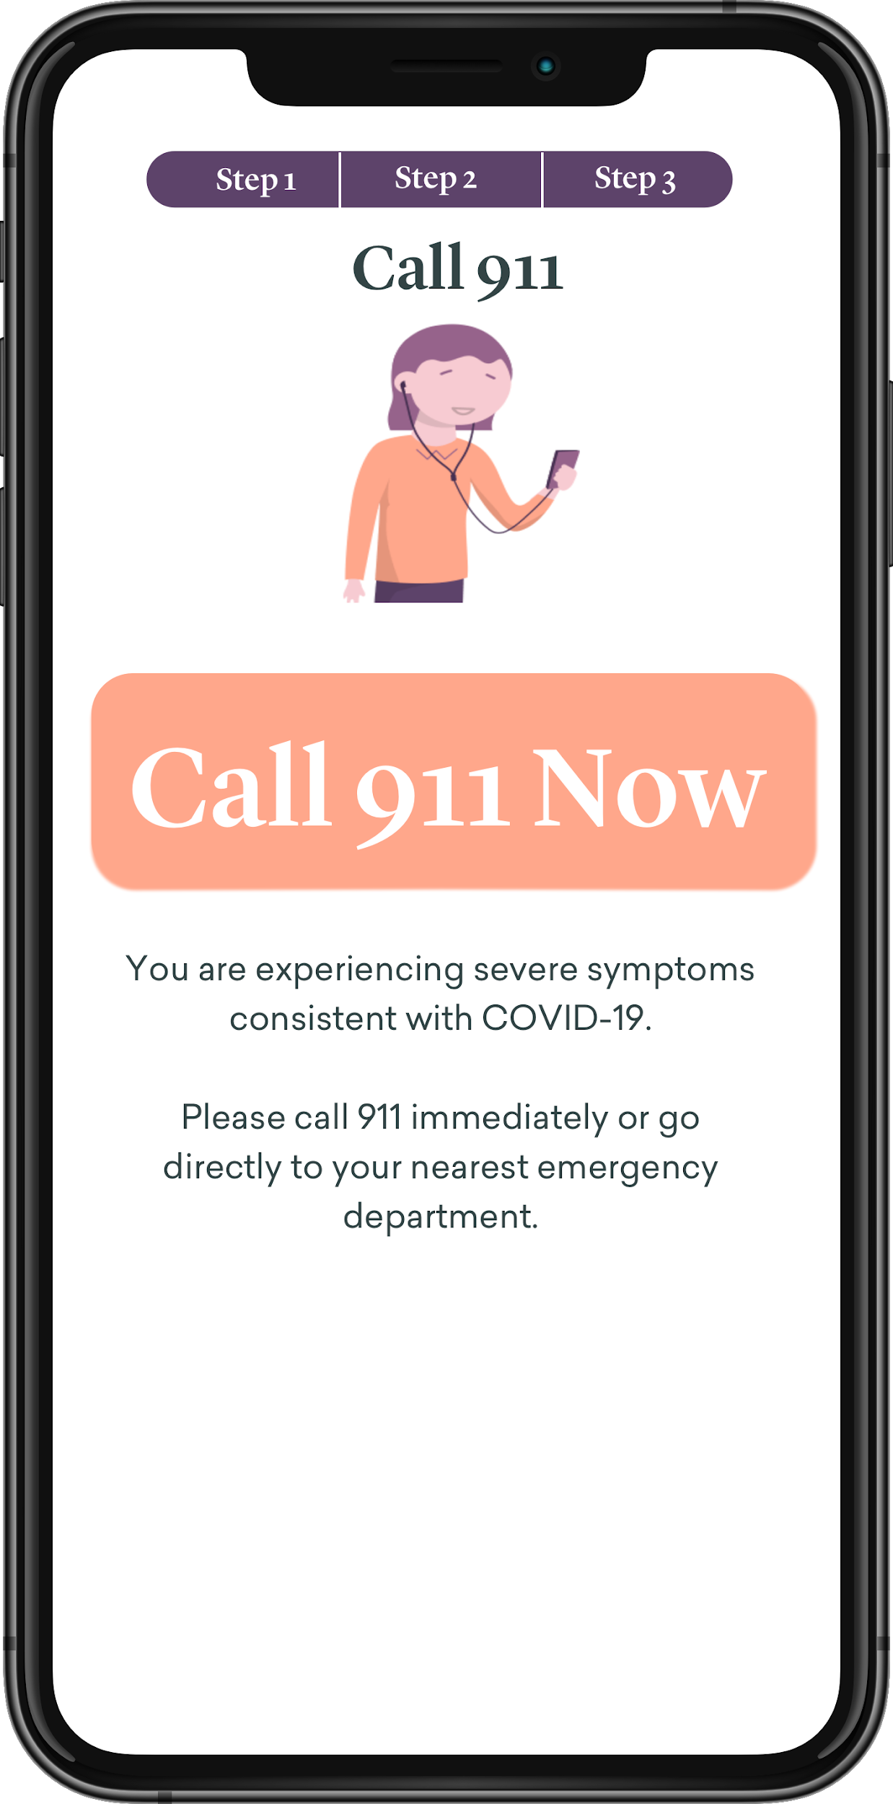
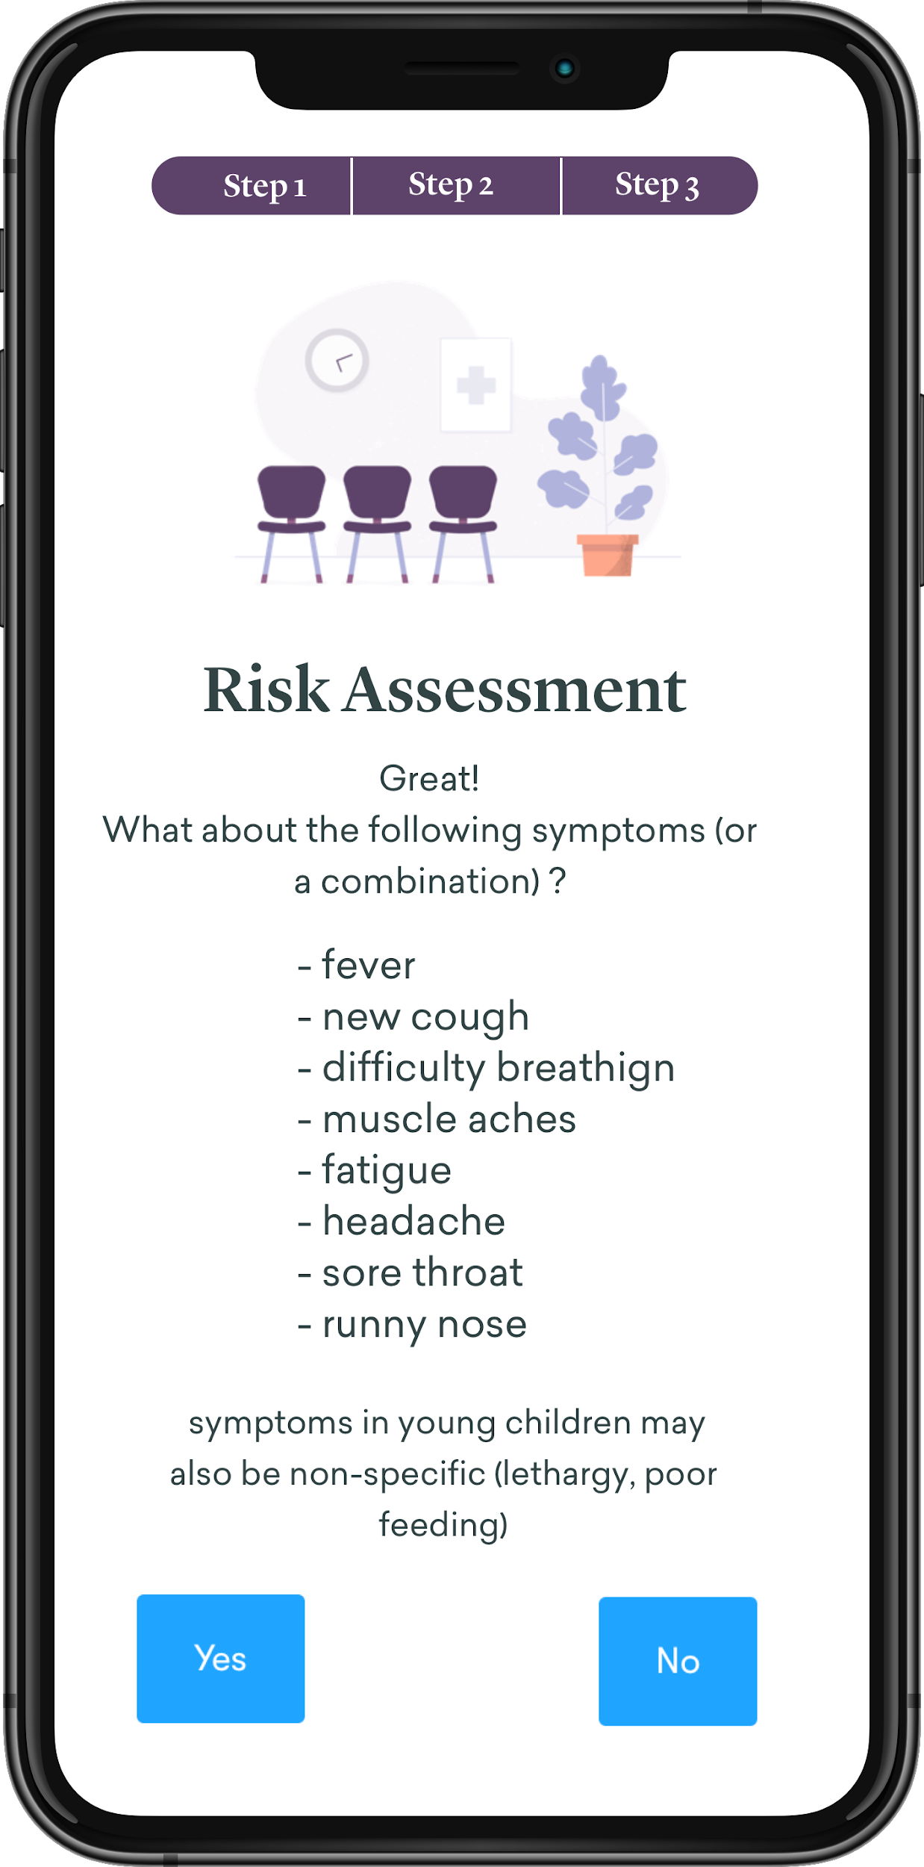
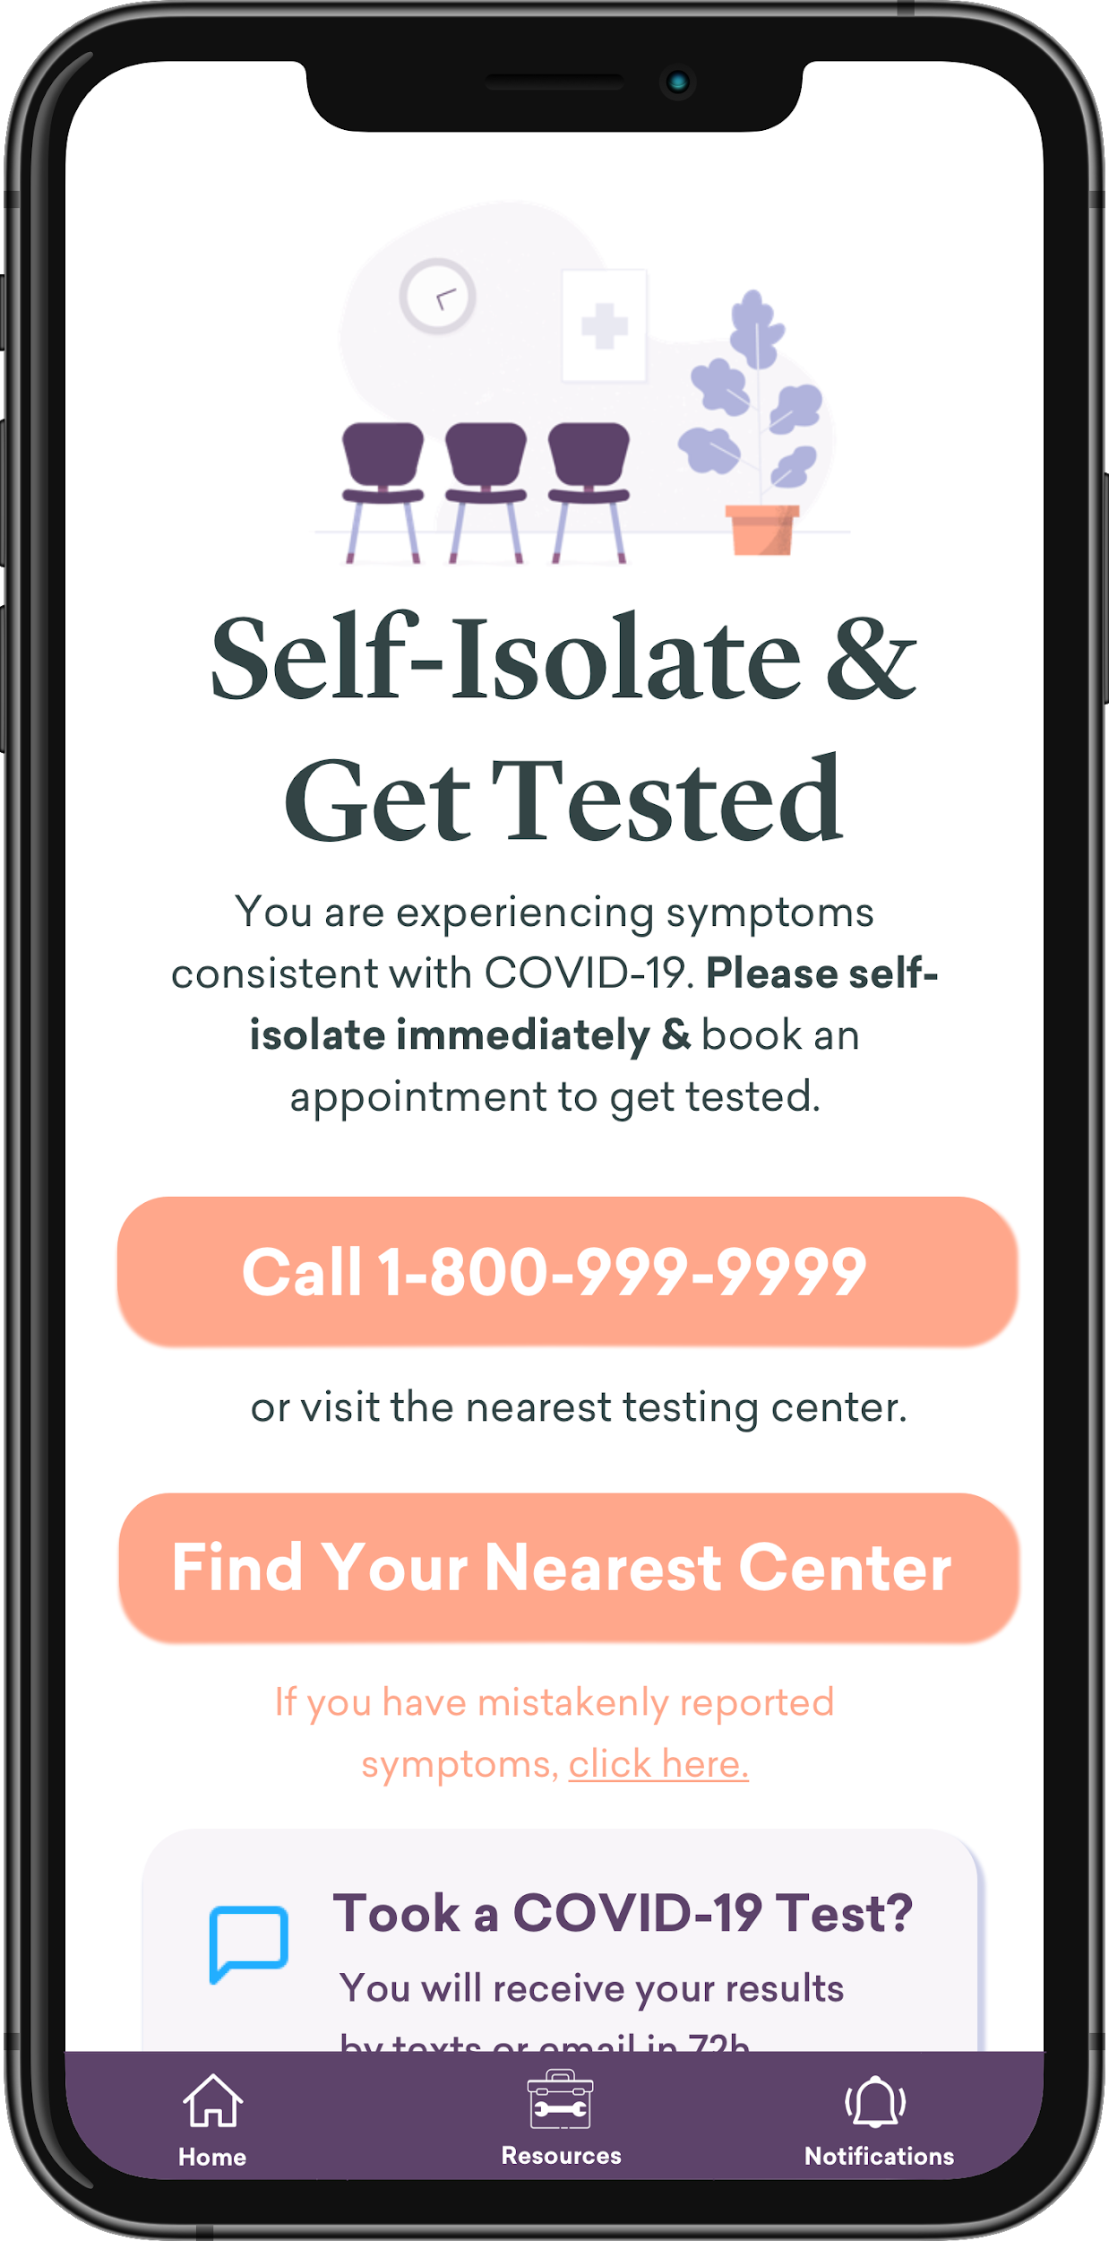
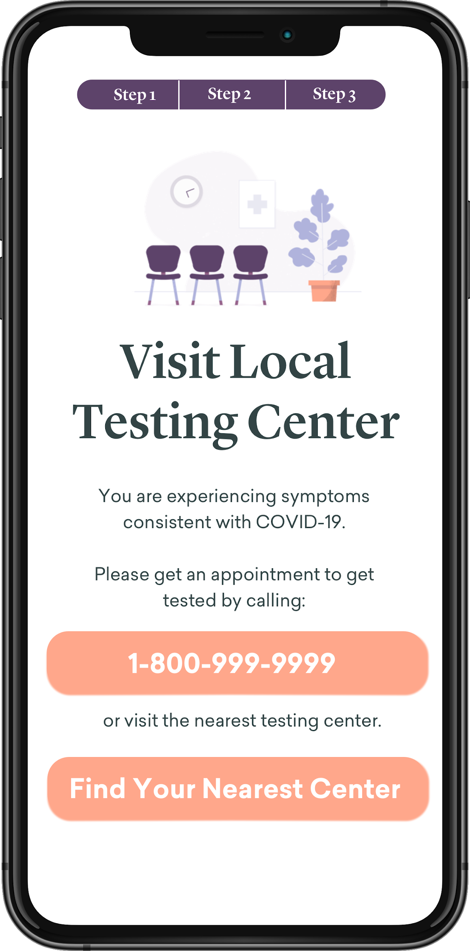
Symptom Flow - Has Symptoms (Not a HCP)
Intro screens + value prop explained (geolocated)
App Activation
Initial Assessment
Home Screen after a person reported mild symptoms will default to Self-Isolate & Get Tested every time they return to the app.
Option to ‘reverse’ reported symptoms (in case user was just playing with the app)
If person answers Yes to “I have symptoms”, they will first be prompted with the ‘severe’ symptoms screen.
If they say No to the severe symptoms, they will be sent to the “Mild Symptom” screen.
Yes
Yes
Call 911
“Severe symptoms”
No
No
Yes
If person does not have
Get Tested
“Mild symptoms”

Slide 3
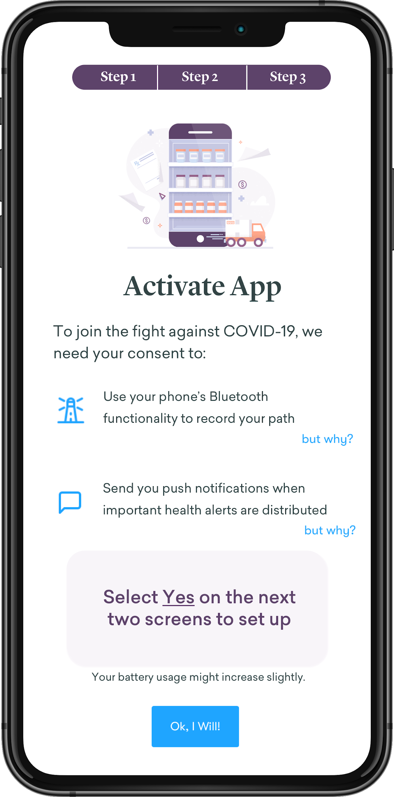
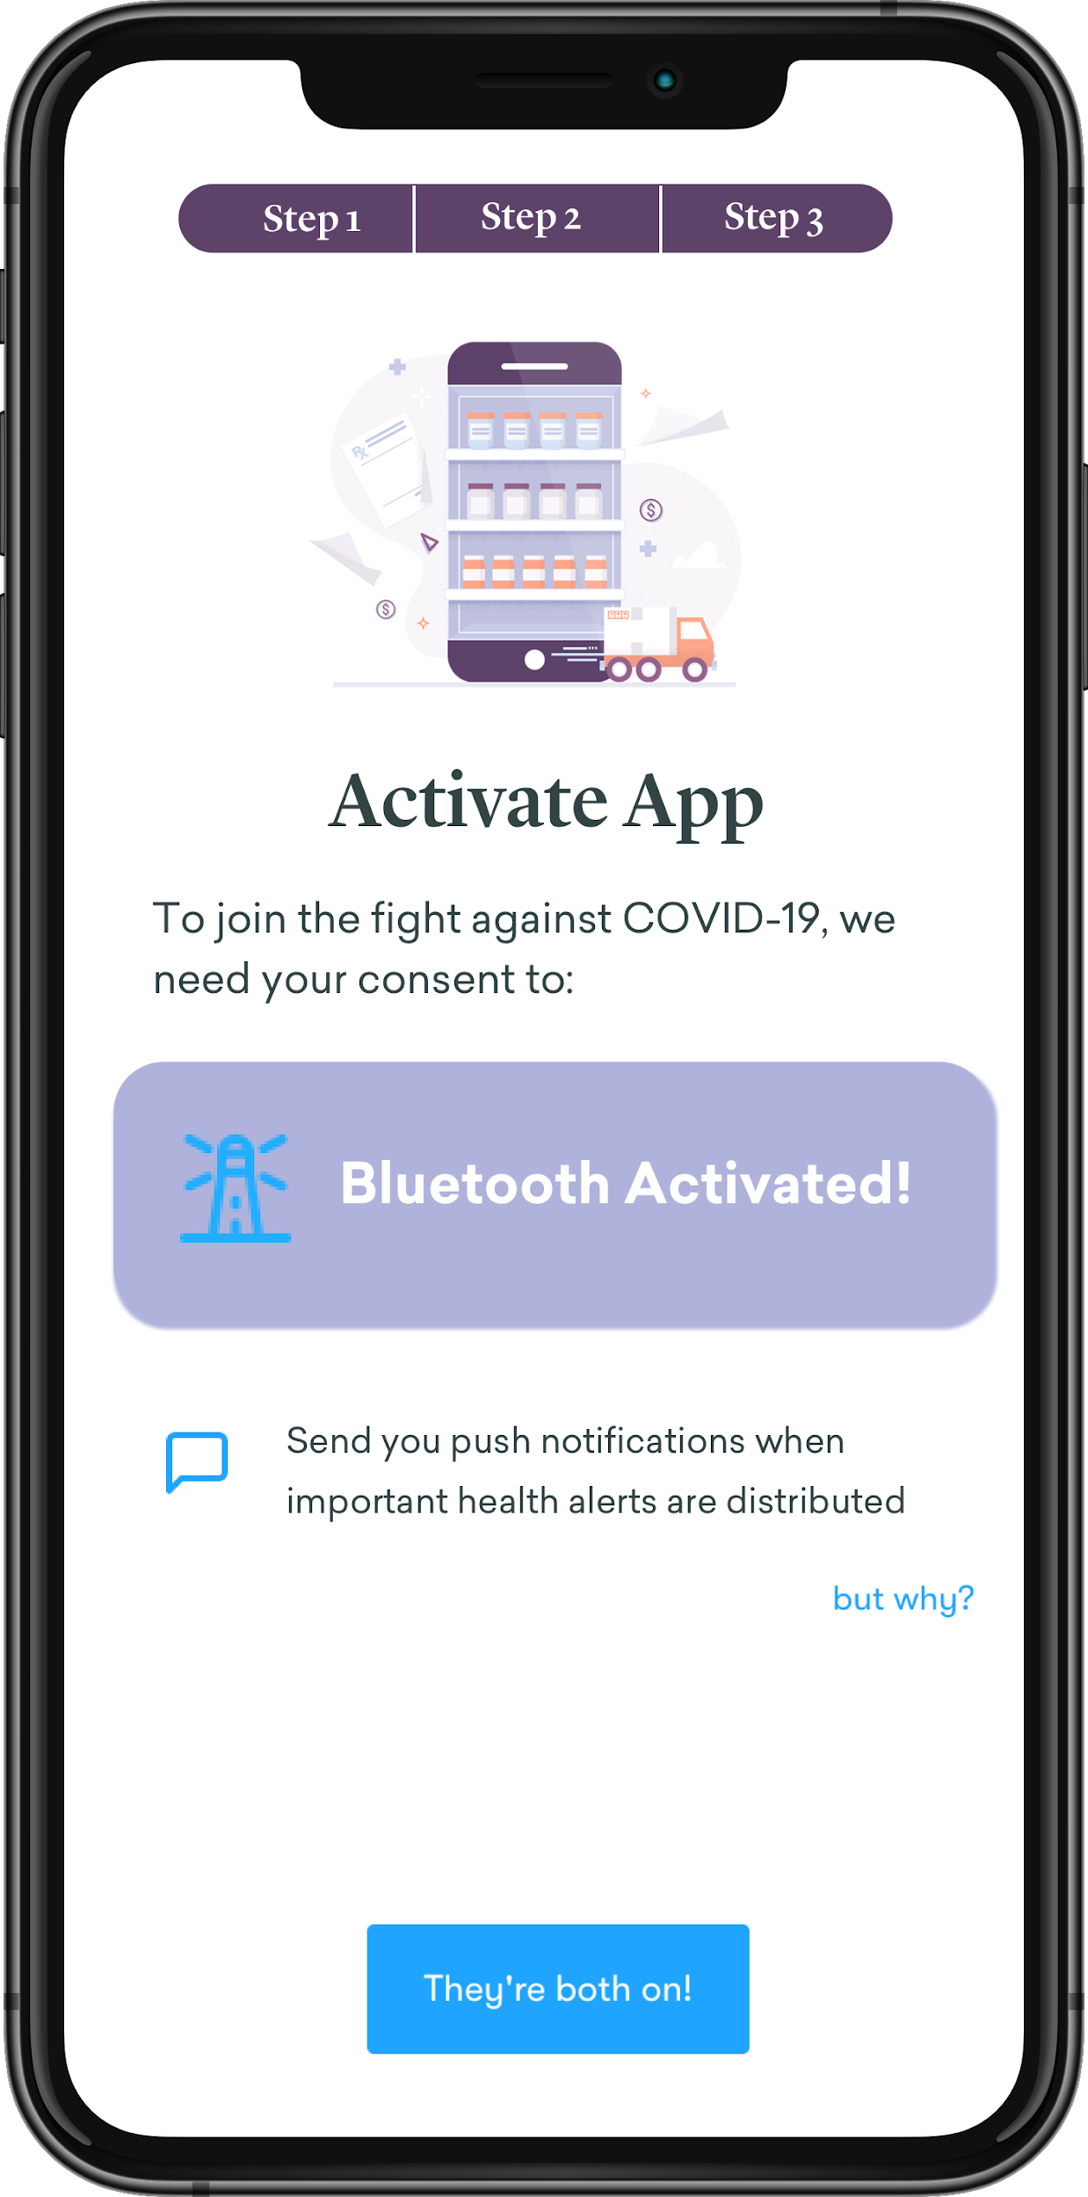
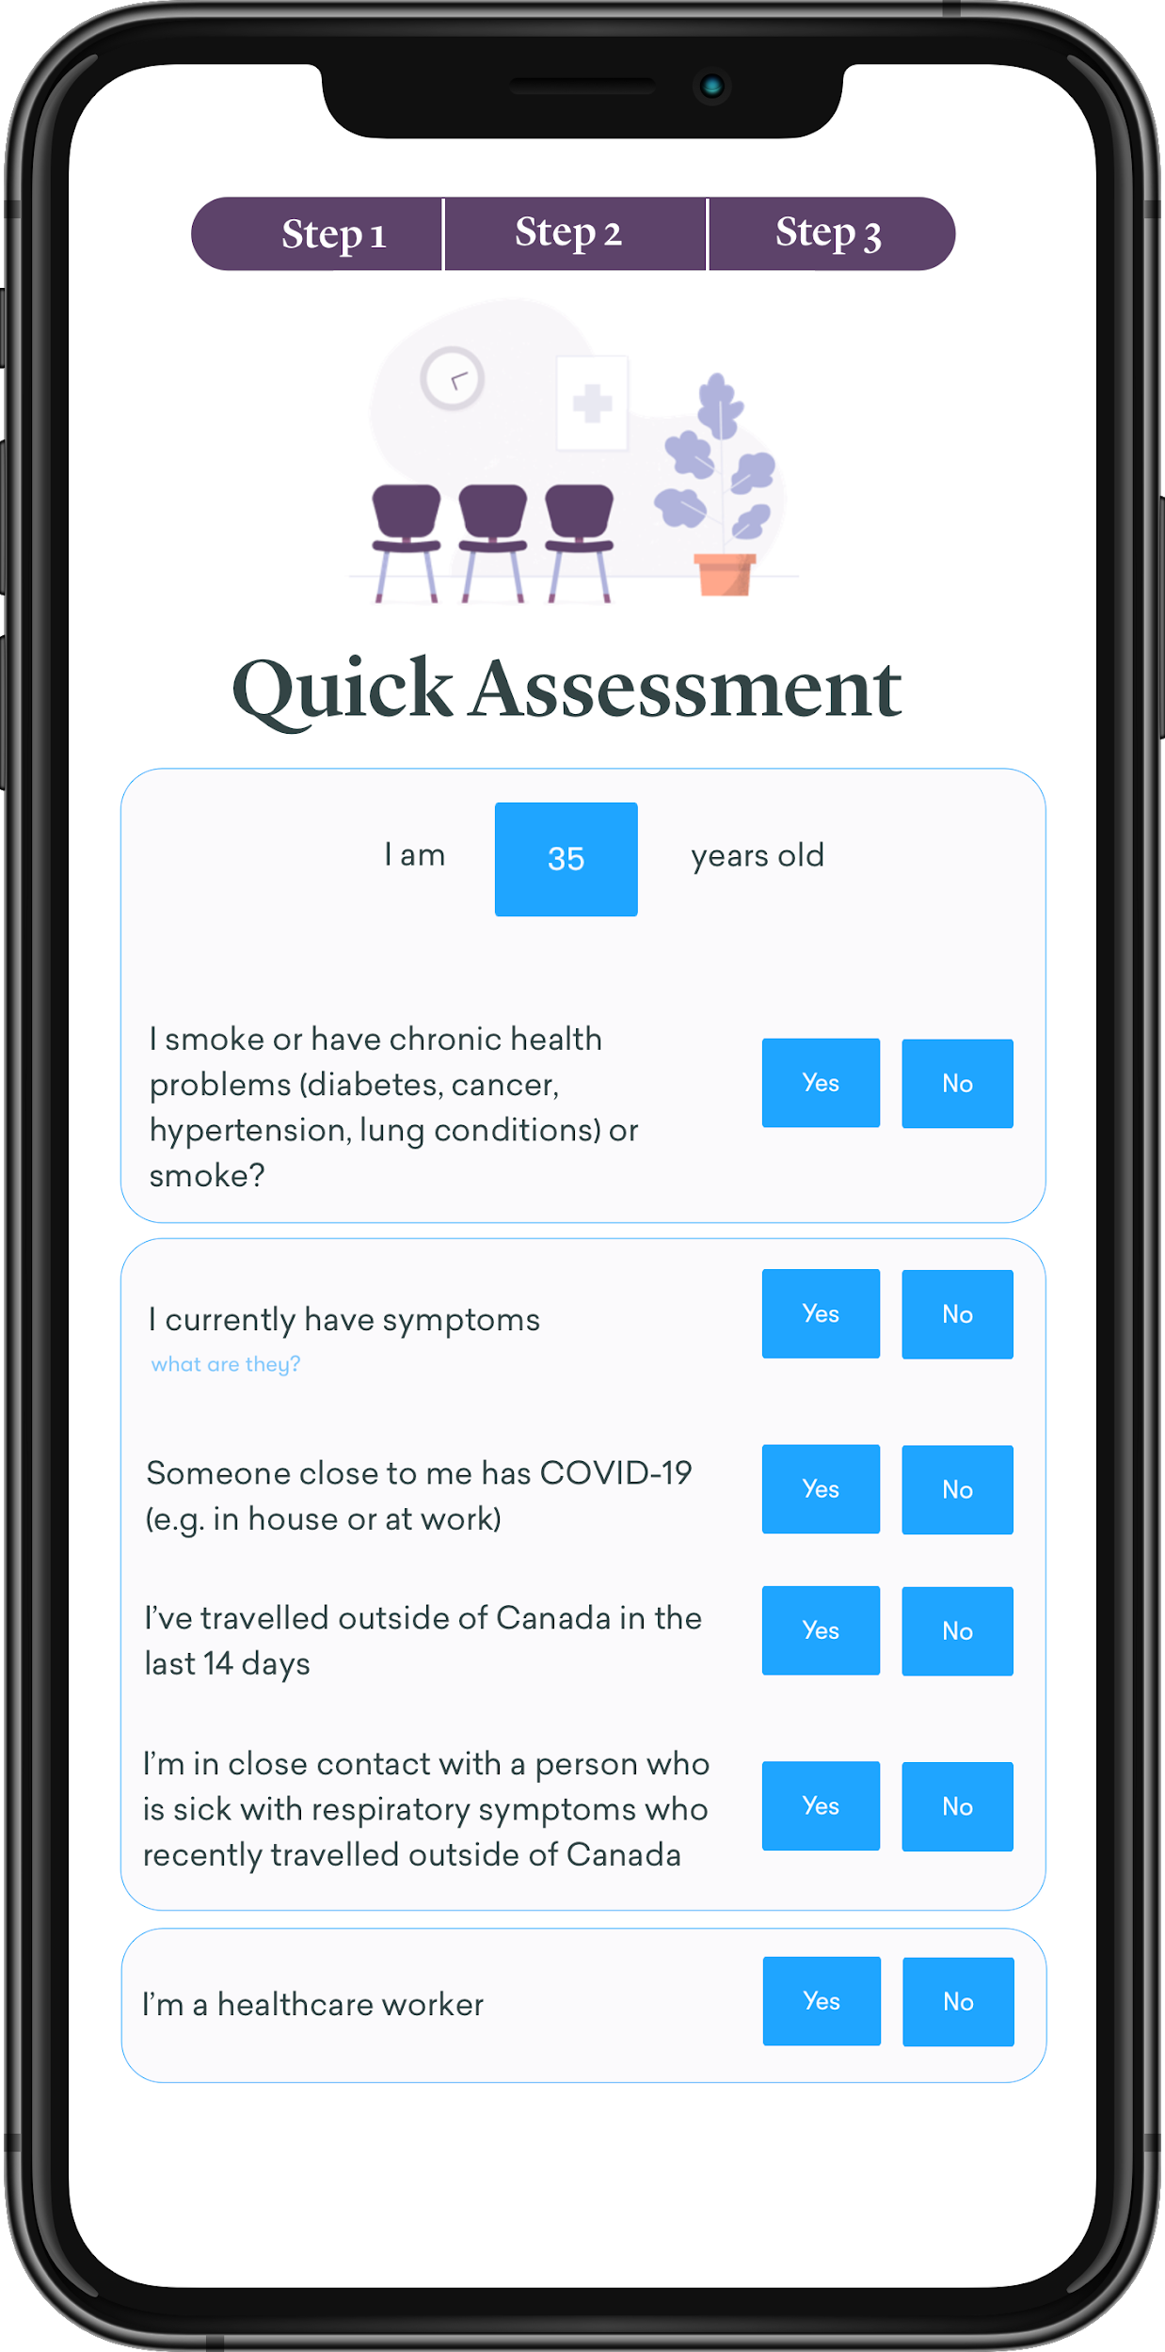
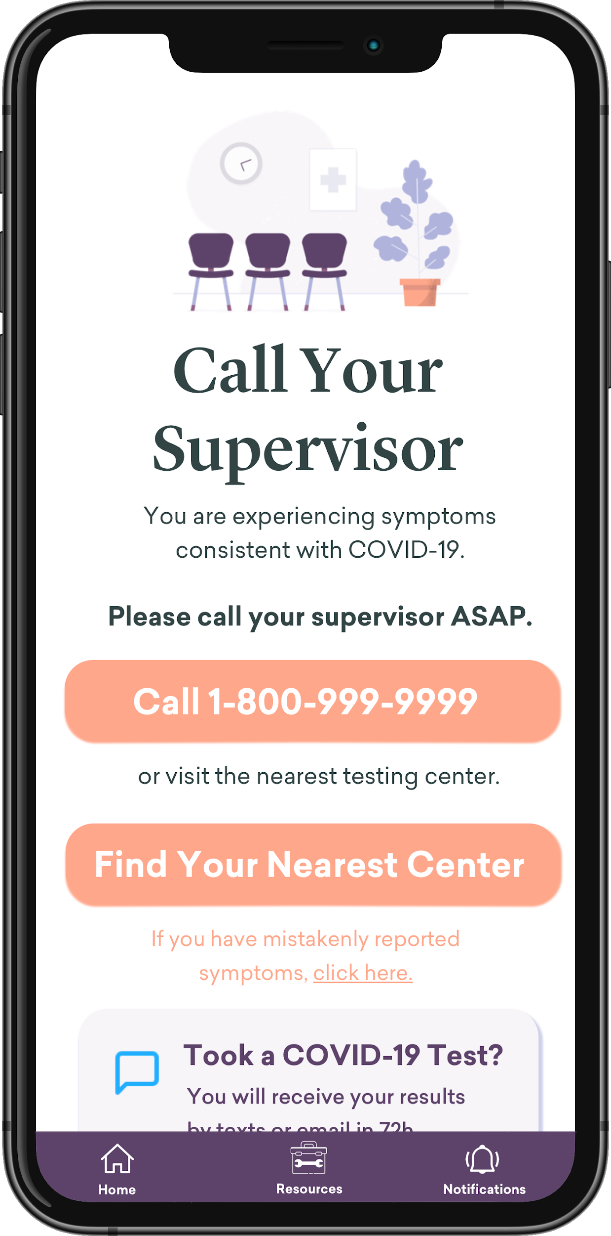
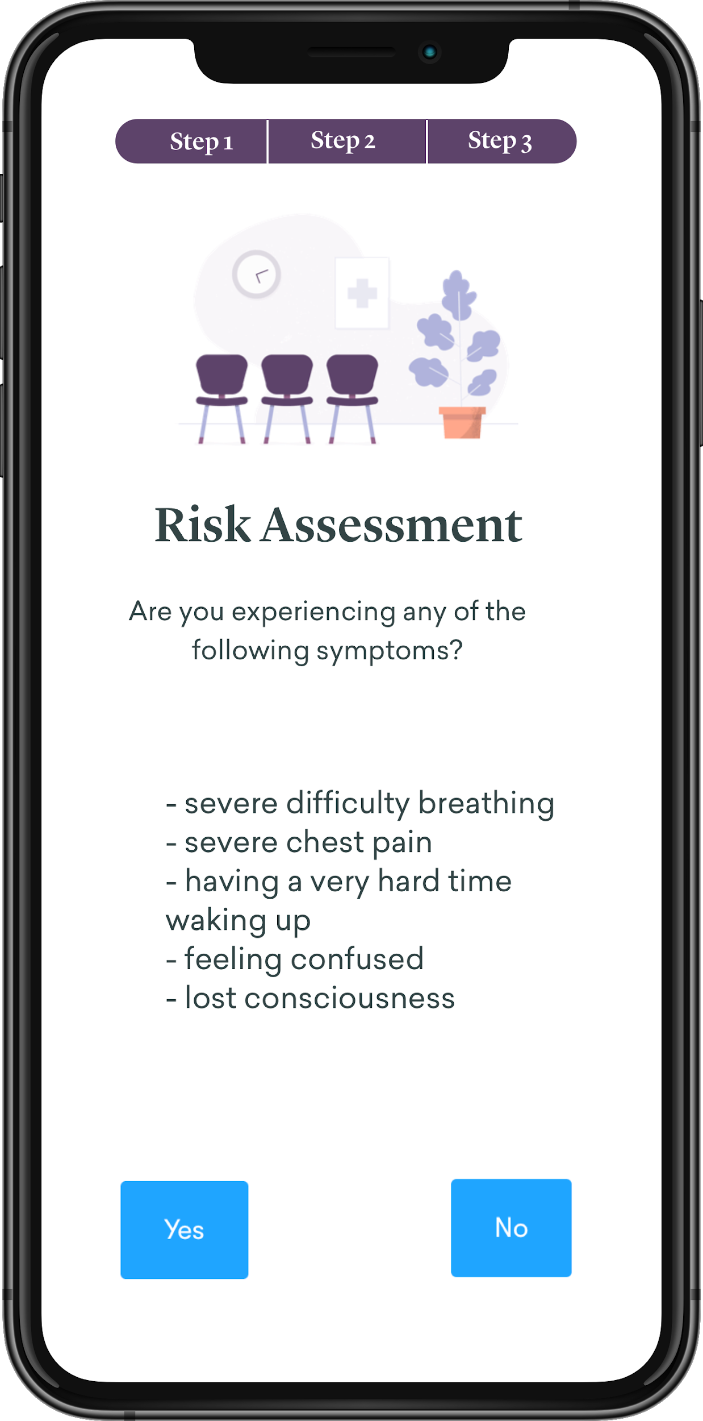
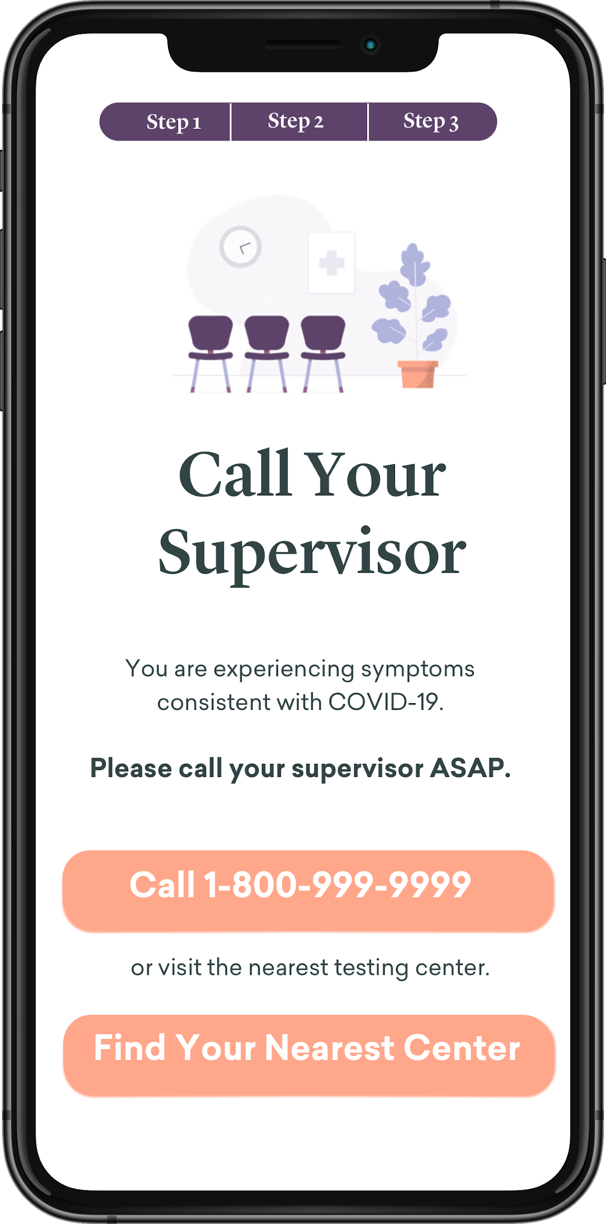
Symptom Flow - Has Symptoms, Is A HCP
Intro screens + value prop explained (geolocated)
App Activation
Initial Assessment
The HCP selects Yes to being a HCP.
They are then asked if they are a HCP who works with COVID-19 patients.
Home Screen after a HCP reported mild symptoms will default to Call Supervisor/Health Care Authorities every time they return to the app.
Option to ‘reverse’ reported symptoms (in case user was just playing with the app)
If HCP answers Yes to “I have symptoms”, they will first be prompted with the ‘severe’ symptoms screen.
If they say No to the severe symptoms, they will be sent to the “Mild Symptom” screen.
Yes
Yes
Call 911 1st, 2nd advise your supervisor ASAP
“Severe symptoms”
No
No
Yes
If person does not have
Call Supervisor
“Mild symptoms”

Slide 4
Intro Screen
Logo + title TBD by branding team
Province logo will be customized according to province (geolocation)
1 second animation at first launch to hide the province logos as they appear (it will take a second to geolocate).
Quick mockups created by The Decision Lab to get us started on a user friendly facing design. Visual identity borrowed from dialogue.co for illustrative purposes only, NOT to be used in production.
Notes:
Sketch file here: https://www.dropbox.com/sh/0ynxocaef79kwm6/AAA0TFnwaXg6eshcq4iTKHNFa?dl=0

Slide 5
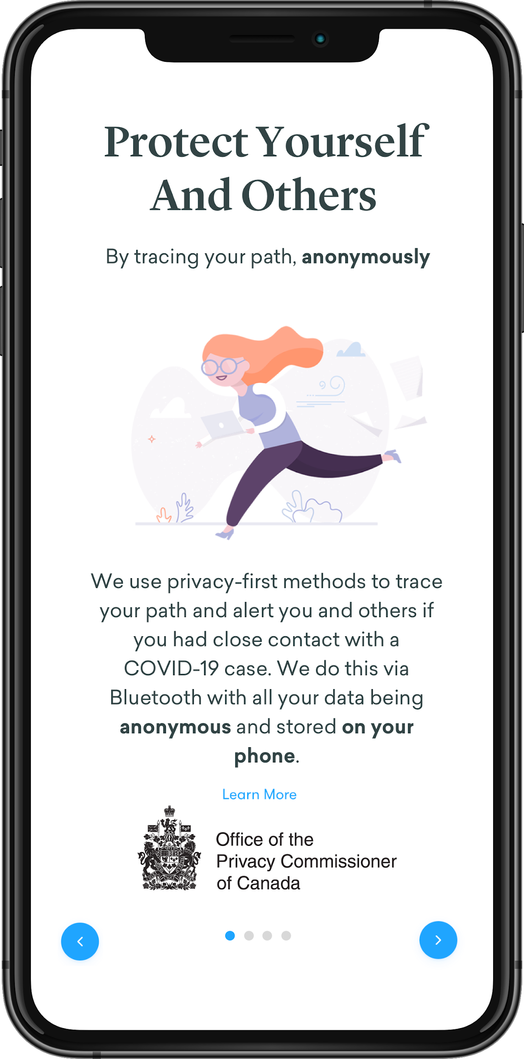
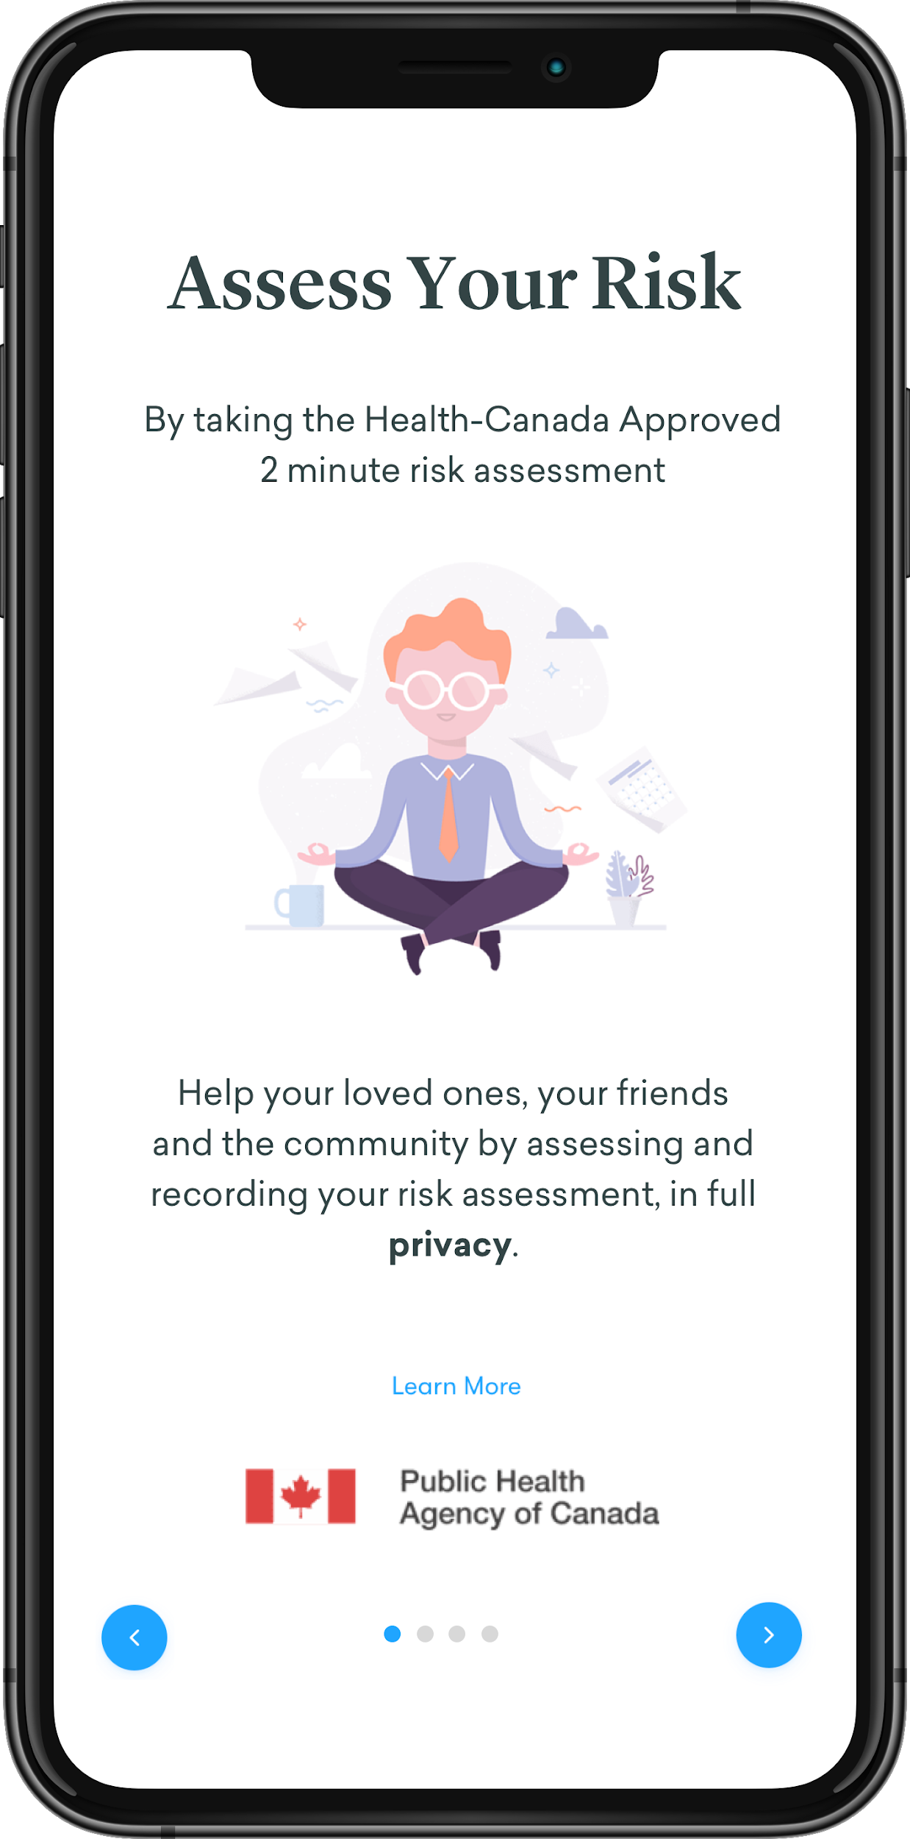
2 Intro Screen
- Swipe, showcasing the features of the app
- Build trust in authorities behind the app
- Instill sense of duty/community
- Could be shortened to 1 screen ?

Slide 6
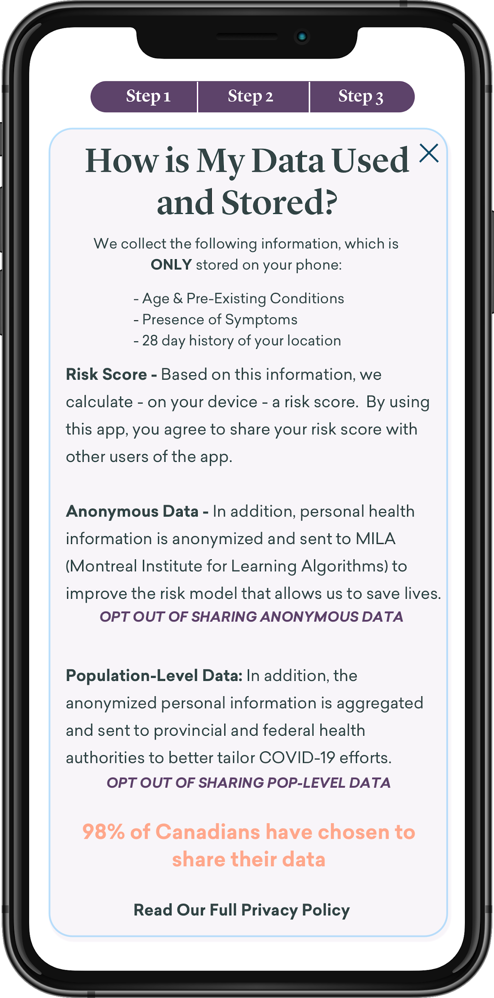
Assumption is that a majority of users will go through these screens without clicking on “Learn More” buttons.
Those that are not convinced, will be able to click on the “why/what is this” links, next to each item to open the prompt that explains why the app needs that.
App Activation (Step 1+ Step 2)
Prompt user to activate location-services and push notification
We could prompt for phone number/email if we don’t do push
OS-level popup for activation on similar screens, with a ‘progress’ report that highlights the activated functionality.
Option to ‘learn more’ about each of the items, explaining privacy features in more details, etc.
Ability to OPT-OUT of sharing data with MILA/HC - TBD if we actually want that.
Link to TDL desk research on Canadian privacy attitudes
Opens pop-up
Users can opt-out from MILA + gov. Also available in profile to opt-out later on.
Option to read the entire privacy policy in detail (externally)

Slide 7
Assessment - Step 3
IMPORTANT DEV NOTE: App should collect data/be used without the user completing this screen (as soon as they have activated GPS+notification and consent). Need to have ability to dynamically change these questions without app updates (if suddenly some questions are not relevant anymore)
Shows up right after activating GPS/Notifications + Consent
Abhinav’s flow to check what immediate actions are required
Decision-Tree Flow: Depending on what they answer (yes to symptoms, yes to health care worker, they will be enrolled in a more complex flow asking follow up questions - elaborate on whether they work with COVID patients (question will drop down below), have 911 symptoms or mild ones, etc).

Slide 8
Self Check
Shows up IF USER SELECTED YES TO SYMPTOMS during onboarding OR IF THEY TAKE THE SELF CHECK .
911 Symptoms First: User selects Yes to symptoms, they’re first presented with the 911 symptoms. If yes, they’re advised to call 911 on the next screen + given any additional information.
Mild Symptoms: If users select to to 911 symptoms, they’re shown the ‘normal’ symptoms prompt.
If mild, they are advised to self isolate and get tested.
Buttons change opacity/becomes active once the buttons are selected.
They are then returned to the homescreen, with the order of ‘action items’ changed - each province can select whether they want to ‘nudge’ the user to get tested, even with mild symptoms.

Slide 9
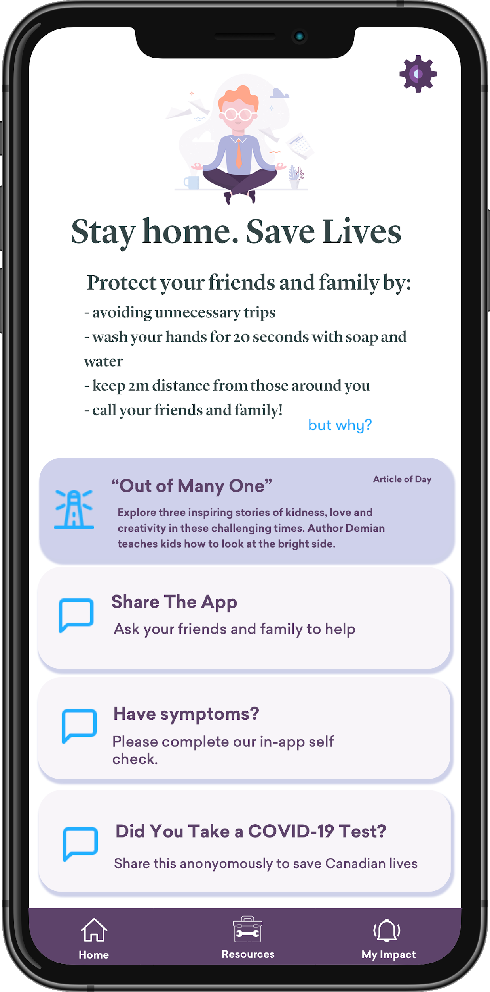
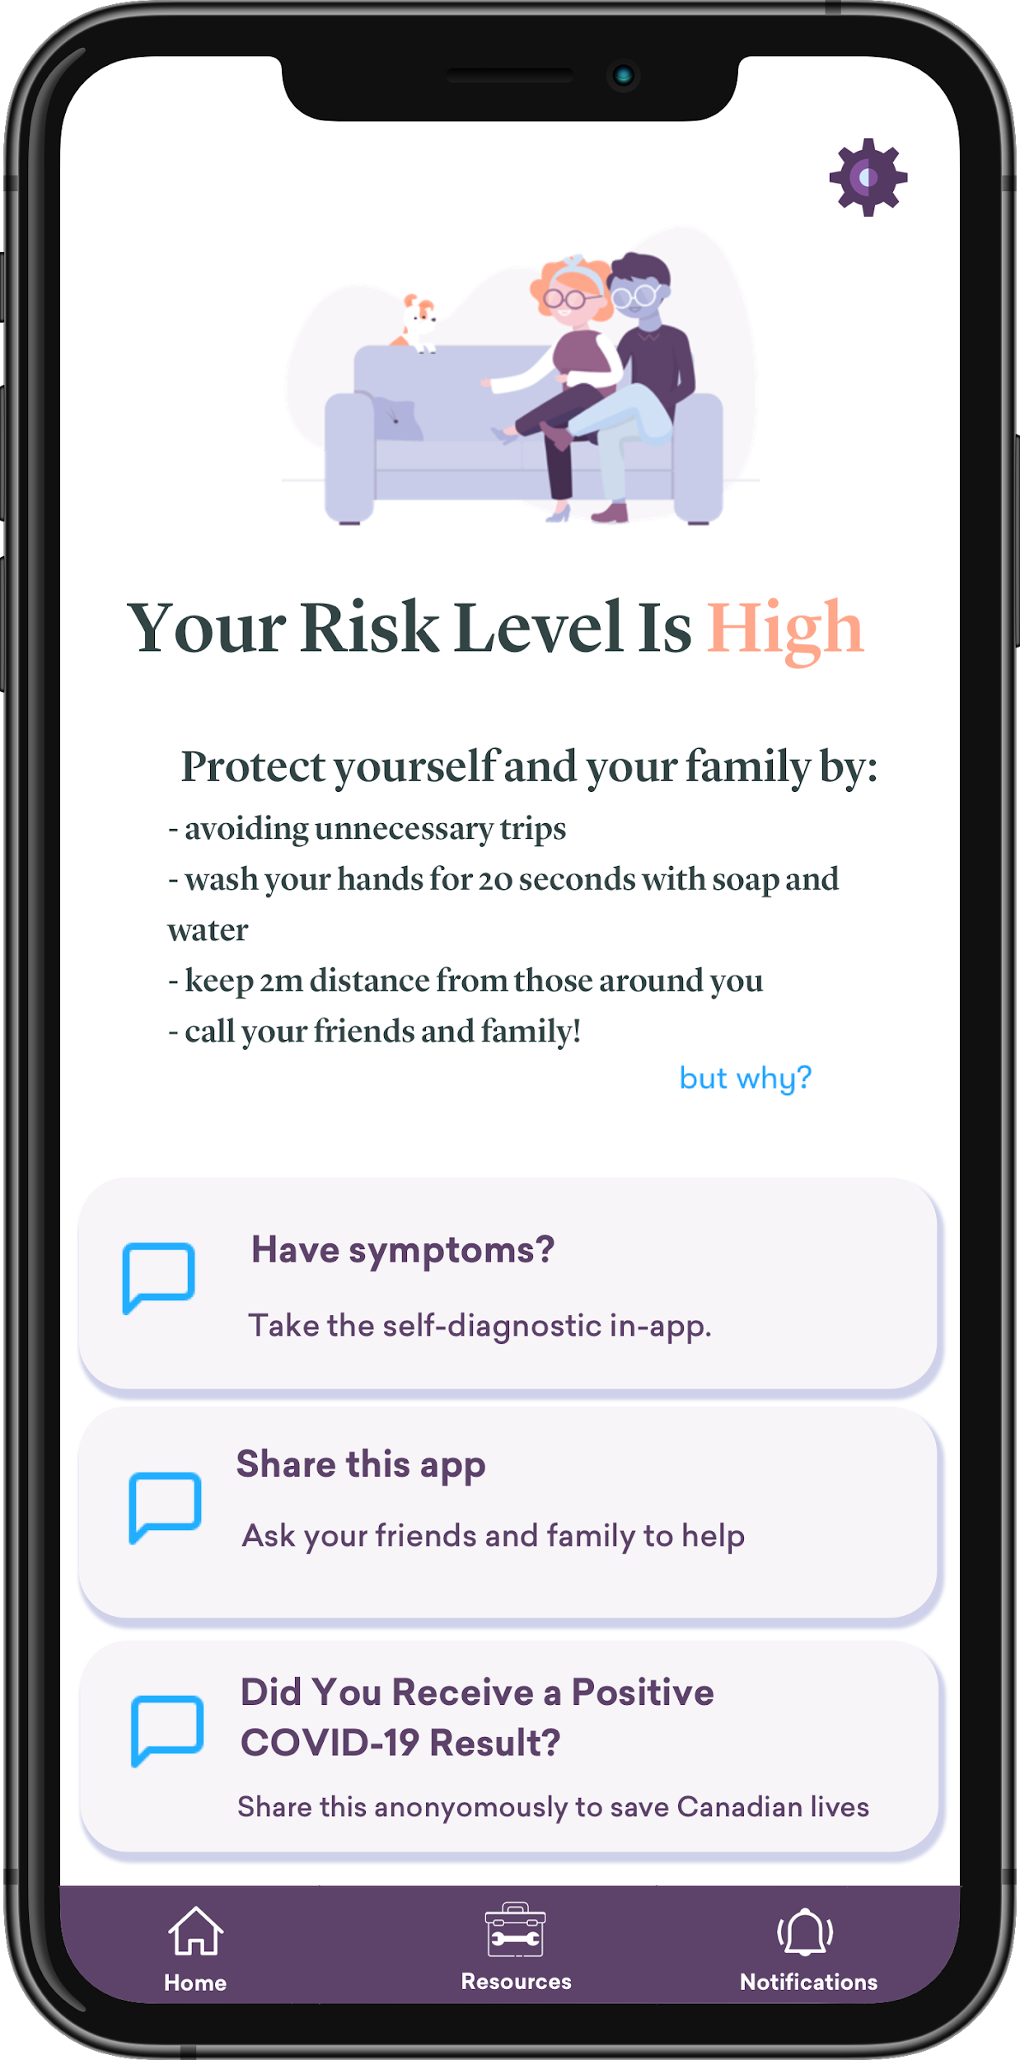
All done - App onboarding complete
- Home: User answers no no no to all, they’re presented with the Home/Dashboard. Since system sees them as ‘low’ risk, there is no risk displayed.
- Binary in v1: low risk = show the advice given by the province. High risk = self isolate and watch for symptoms, etc. Positive test (self reported) = quarantine.
Dashboard Actions: The screen will have different sort of cards/action that prompt the user to take different actions, depending on their risk level, situation. E.g. if their risk level is high because they’ve been in contact with someone, the most prominent action recommended will be the self check. If their risk level is low, the most prominent one will be to complete additional, optional questions to improve risk assessment (e.g. do you take public transit, etc). DEV:THESE CARDS NEED TO BE DYNAMIC (NEW CARDS WITHOUT APP UPDATE)
- Menu Bar: The bar menu on the bottom will lead to 2 different screens in v1: Home (showing risk level/cards) + Resources (gov best practices, livestream PM addresses). Future screens - v2, can be “Notifications” showing risk level changes, etc) and maybe recoveries in your country, etc.
- Referrals: The share the app” should pop the share screen by default (v1) but v2 can lead a referral screen to keep track of referrals, allowing to send reminders, (Wealthsimple example)
- Took COVID-Test: self report in v1. V2 - Health professional needs to push link with token to access that screen.
Recommendations
Action Cards

Slide 10
All done - App onboarding complete (SYMPTOMS)
- Home: User answered YES to Symptoms and NO to 911 symptoms, but YES to MILD ones.
- The app will ask the user to call a number or find their nearest testing center.
- There will be a way to ‘reverse’ the recording of symptoms, in order to avoid any false signals (for the algorithm and the UX as well), in case the user was just trying out functionality.

Slide 11
All done - App onboarding complete (SYMPTOMS, IS A HCP)
- Home: User is a HCP (regardless of whether they work with COVID19 patients or not) answered YES to Symptoms and NO to 911 symptoms, but YES to MILD ones.
- The app will ask the user to call their supervisor/health authority in their region do termine next action.
- Similarly, there will be a way to ‘reverse’ the recording of symptoms, in order to avoid any false signals (for the algorithm and the UX as well), in case the user was just trying out functionality.

Slide 12
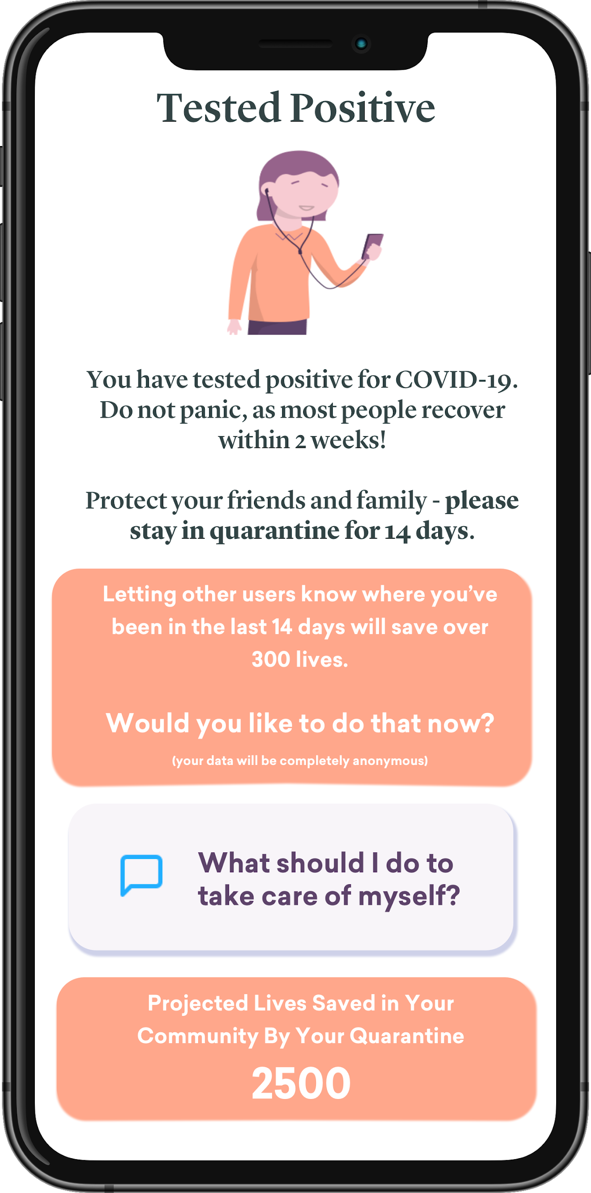
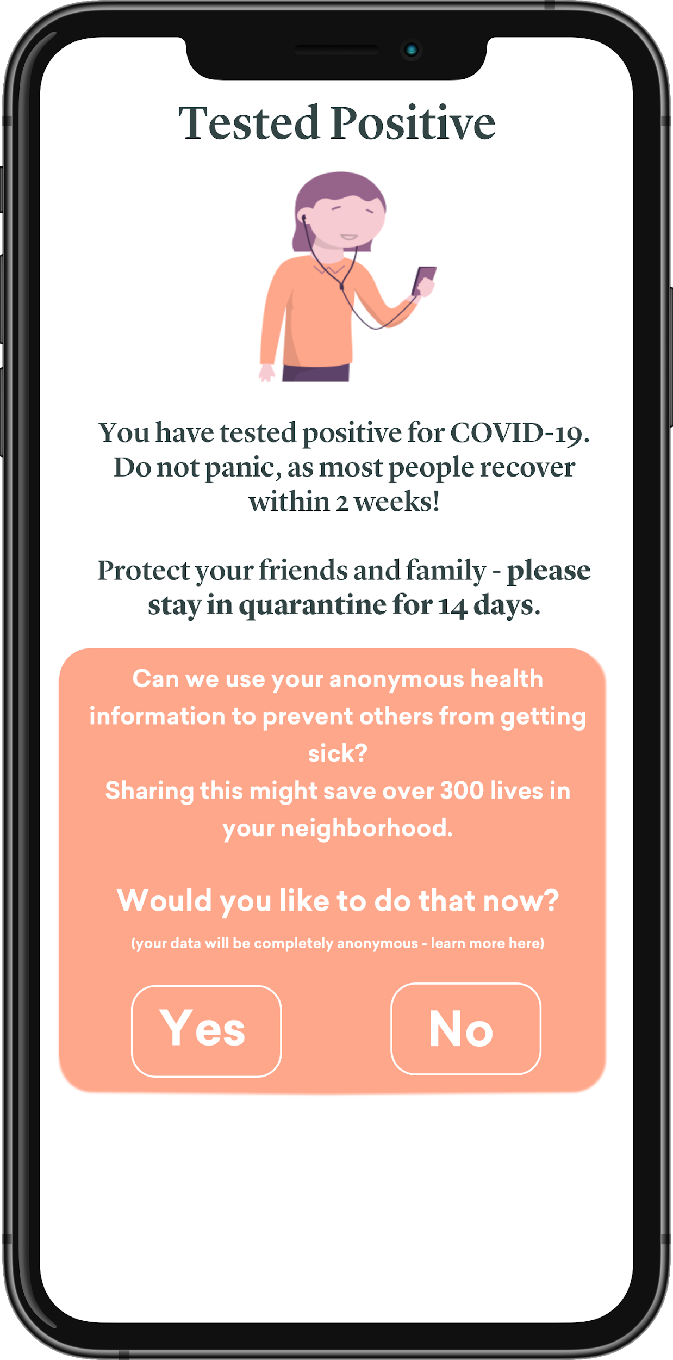
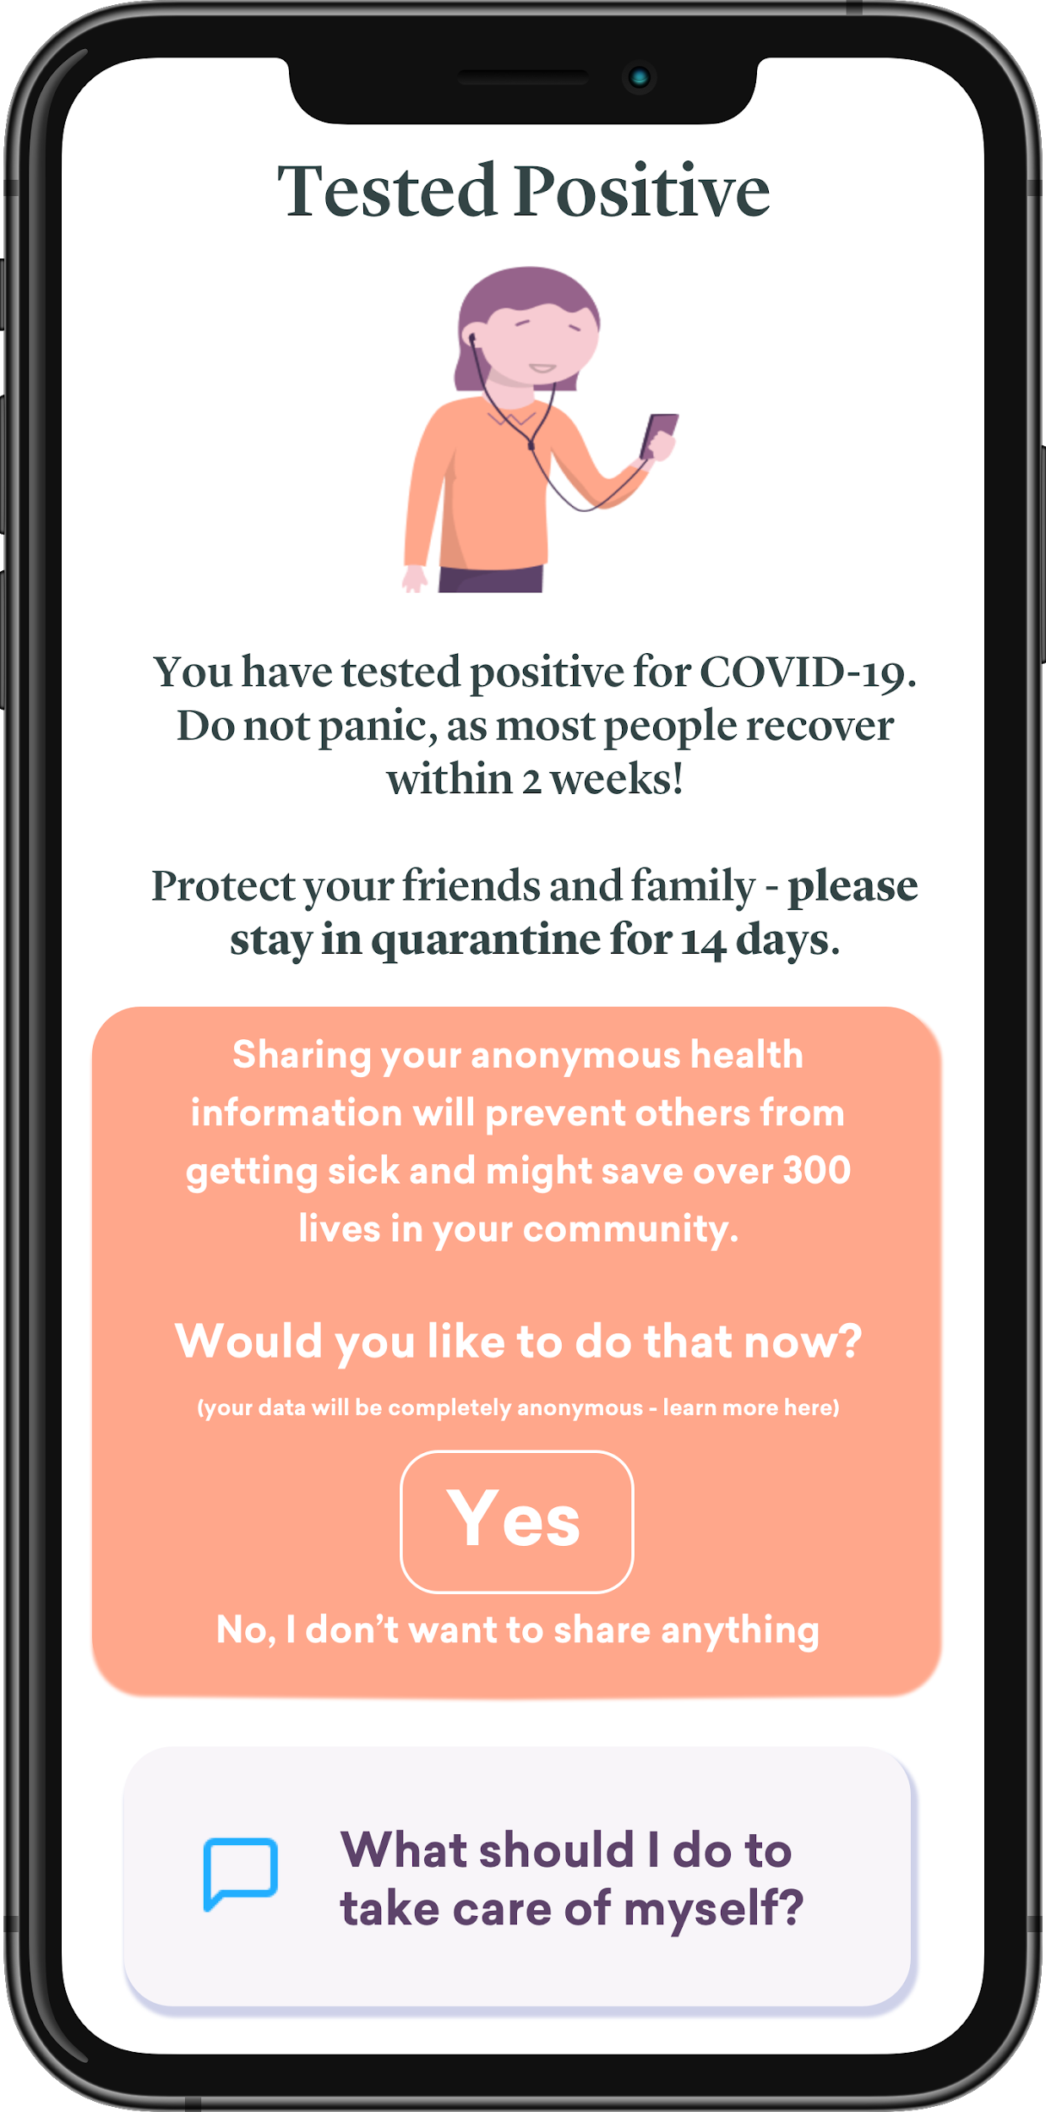
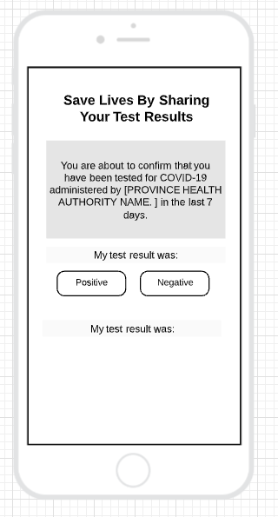
Tested Positive - Self Report
- v1: User self-reports positive test
- v2: Screen only shows up when they click on the link sent via text message/email by the public health authorities.
- The text/email will automatically lead to this screen if positive, and to another screen if negative.
- Screen will contain strict guidelines and helpful information on how to cope with the disease, when to call 911 or go to the hospital, as well as social distancing tips/requirements (or threats if we want..)
-
Needs to be redone based on self-reporting. Q: Do we want to users to self report locally, without sending any data back to MILA? E.g. - User first confirms that they tested positive (app stores the value) and THEN
We ask them if they want to share with MILA for modeling? Or 2 in 1 - cannot confirm in app without sending to MILA at same time?
Communicate
Alternate version - System Level Pop-up
(no action can be taken without selecting)
Alternate version - App Level Pop-up
(inside app, freedom in how it’s designed)

Slide 13
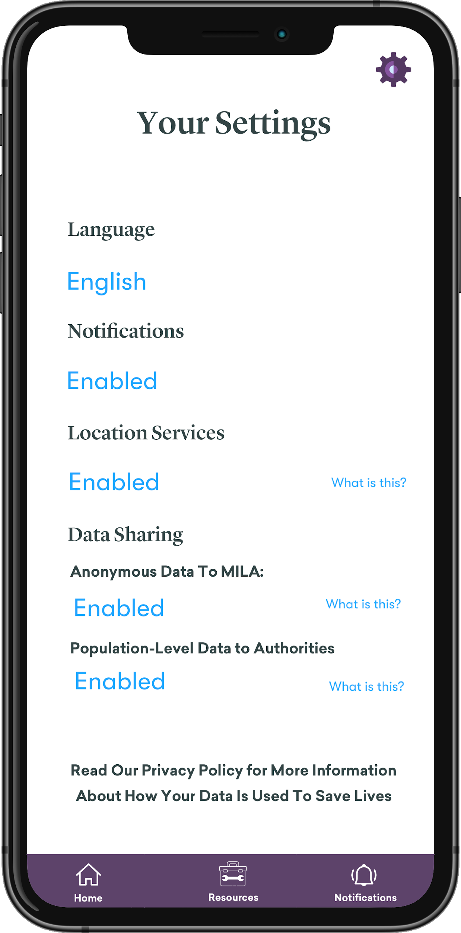
Settings Screen
Can be accessed from dashboard.
Change language and see status of push notifications, location services, and the two data policies you can opt out of.
Some of these need to be in red if they are not active and nudge the user to turn them on - e.g. activating data sharing will save x lives…

Slide 14
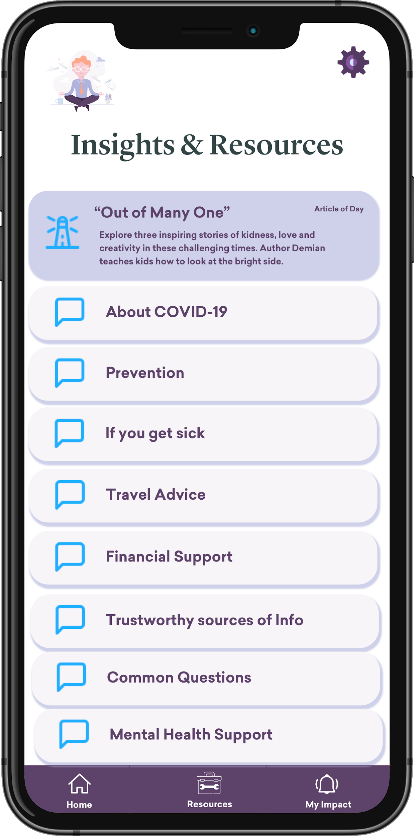
Resources Screen
Needs to have the same resources as the federal COVID app.
“Article of the day” or inspiration of the day - something positive, would show up on top, until it is read. This would also show up in the ‘action cards’ in the dashboard.
We can also push notification the article once every few days (without becoming too annoying), carefully monitoring interactions (opens/reads,etc).
Can open in-app browser or external?

Slide 15
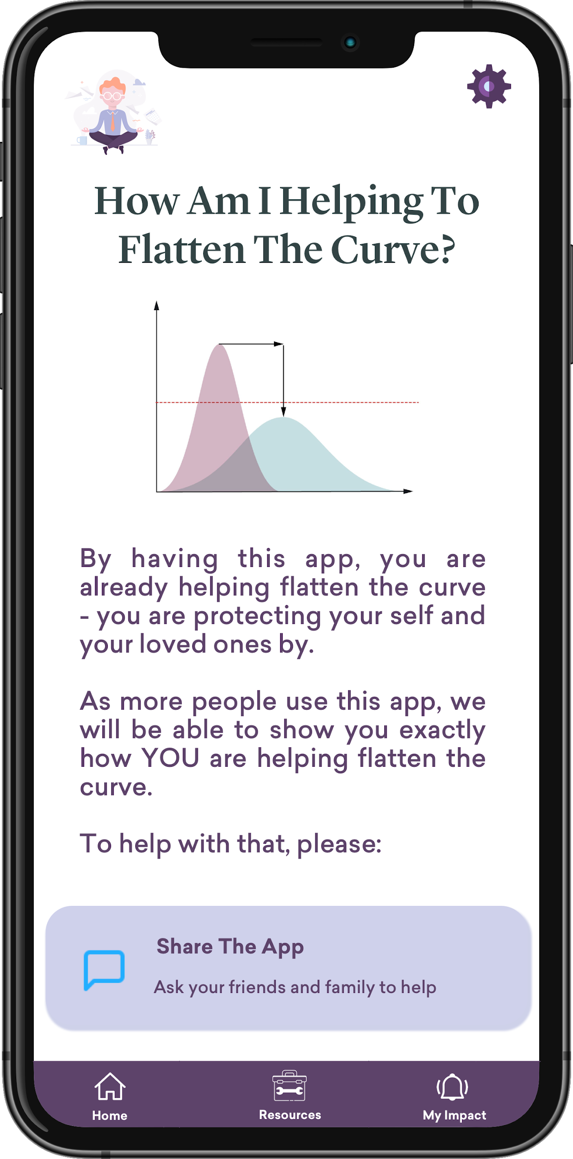
My Impact Screen
Dummy screen in v1.
Will just be a "dumb" screen in v1, with the intent of later showing how individual users are changing the course of the pandemic (in their province or the whole country). Think wealthsimple bars - needs to be done carefully to not get the user ‘down’ if things are going badly and the number of cases rises.
Copy congratulating people that they’re already doing their part, and that more things will be shown here as more users get the app. Prompt to share.
Bottom: Button to open native share (same as the 'share action' on the dashboard)

Slide 16
v2

Slide 17
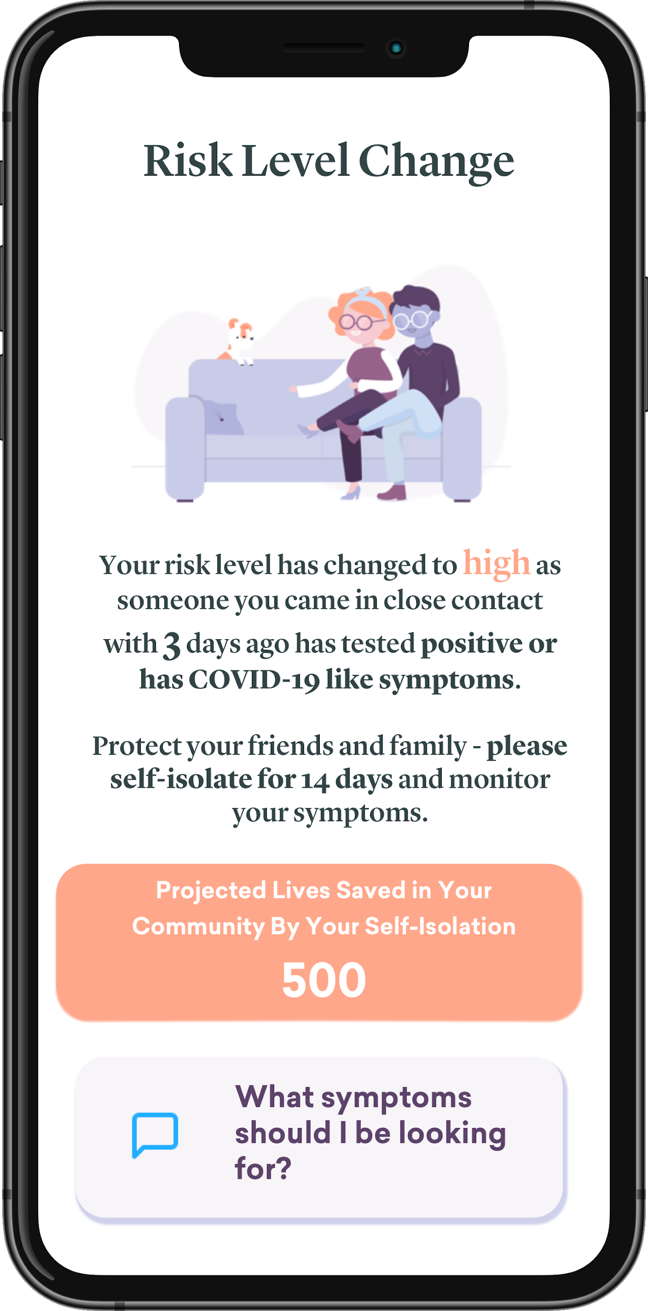
Report Positive Test/Symptoms
- Positive Test: Once a person gets tested, and the diagnostic is confirmed (via email/phone link), the users that came in contact with will receive this notification.
- Symptoms: We can consider sending notifications when people have started exhibiting symptoms -
- This would be much softer - “Somebody who you came in contact with feels sickly, you should monitor how you feel for the next few days”
- Considerations: Need to have a confirmation screen in self-diagnostic part of the app if we go forward with that approach, to avoid people getting ‘false’ notifications.

